Slide 1

A Project Presentation On Car Assemble And Service Station
Submitted By
Parthiv B.Patel Exam No.13084221106
Khushbu B Modi Exam No.13084221049
Group No : 42
M.Sc.(Information Technology)
Semester-IV
Submitted To
Department Of Computer Science-IIC,
Ganpat University, Ganpat Vidyanagar -384012
Jan/May.- 2015

Slide 2




Project Profile
Project Title | Car Assemble And Service Station
Objectives | Our site is useful for internal management of company for Book Appointment for Service, Job Cart, Stock, Worker’s task. Customer can search second hand Cars.
Front End | Visual Studio 2013
Back End | SQL Server 2012
Other Tools | Microsoft Word 2010, Microsoft Visio
Group No | 42
Developed By | Parthiv B. Patel (Exam No. 13084221106) Khushbu B. Modi (Exam No. 13084221049)
Submitted To | Department of Computer Science – Ahmedabad
Time Duration | 120 days

Slide 3



About the Organization
Company Name | Aspiration Software Solution & Consultancy
About | Aspiration is an IT solution provider company based in India and United States with its eminent and potent team. We are Providing our clients with the security and operational development framework they require. As an aspiration software consultant, our vision is to be recognized and respected company as one of the technology updated company by our quality of work.
Address | 3 Raju Complex, Opp. Janta Ice-Cream, Gurukul Road, Ahmedabad- 380052
Establish In | 3/5/2010
Man Power | 15 Employees
Email Address | shyam@aspirationsoftechs.com
Contact No. | +91 7874391191
Website | www.aspirationsoftechs.com

Slide 4



EXSITING SYSTEM
It is semi manual system.
Customers must have to walk-in at service center every time to get services
& Fit Accessories.
Sometimes it happens crowded vehicles.
Customer has to specify manually problem of his vehicle and what service they want.
Customer has to count number of services and his current package.
Record searching process are very time consuming.
For any complains and feedback, customers have to come or call.
Stock is managed manually.

Slide 5

Need For New System
Provide online service appointment.
Customer can check how many service he/she took.
Assign task of workers online.
Customer view his or her particular service detail and also a task status
of it.
Online billing.
Operator can easy to manage stock and data.
Admin can see reports according to date.

Slide 6
Project Analysis
Hardware Requirement (Minimum):
Server
Processor | Intel Core 2 duo
Hard Disk | 4 GB Free Space
RAM | 2 GB
Client
Processor | Intel 1.7 GHz
Hard Disk | 1 GB Free Space
RAM | 1 GB

Slide 7


Software Requirement (Minimum):
Server
Operating System | Windows Server 2003 or Any other Compatible Server OS
Web Server | IIS 7.0 onwards
Front end | Visual Studio 2013, LinQ framework 5 with C#
Back end | SQL Server 2012 Express
Other Tools | MS Office 2007, Microsoft Visio
Client
Operating System | Windows XP or Any other Compatible OS
Web Browser | Internet Explorer 6.0 or Any other Compatible Browser

Slide 8





Function Specification
Admin
Operator
Workers
Customer
Login
View Job Cart
Manage Task Sheet.
Manage Profile.
Register and then login
Manage Profile
View Service Packages &
Car Products.
Search Second-hand car
posts.
View Order.
View Service History.
Login
Manage Operator, Workers, Service Packages, Vehicles and Car Products
View Stock
Manage various reports.
Manage Second-hand car posts.
View Charts
Login
Manage Customers
Manage Stock
Generate Job Cart
Assign Task & Vehicle to
Workers.
Generate Bill.
Manage Profile.

Slide 9


System Flow Chart

Slide 11
Use Case Diagram

Slide 12
USE CASE DIAGRAM-ADMIN

Slide 13
USE CASE DIAGRAM-OPERATOR

Slide 14
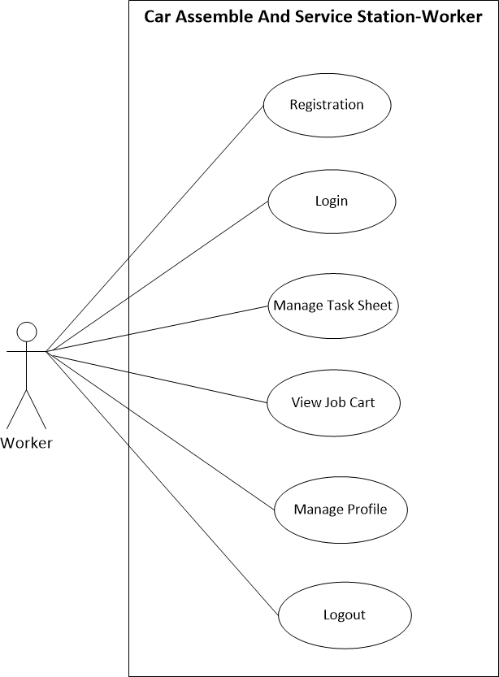
USE CASE DIAGRAM-WORKERS

Slide 15
USE CASE DIAGRAM - CUSTOMER

Slide 16
Sequence Diagram

Slide 17
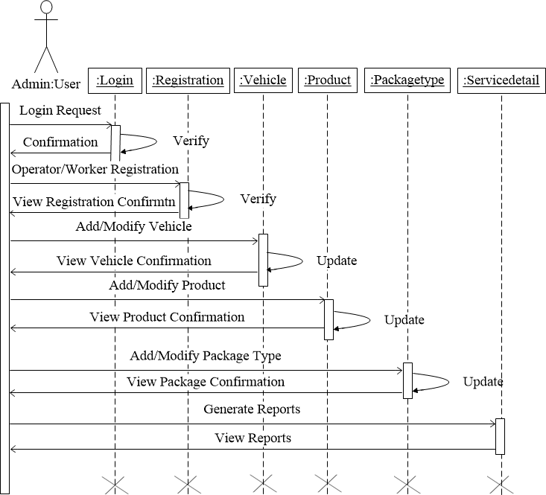
Sequence Diagram-Admin

Slide 18
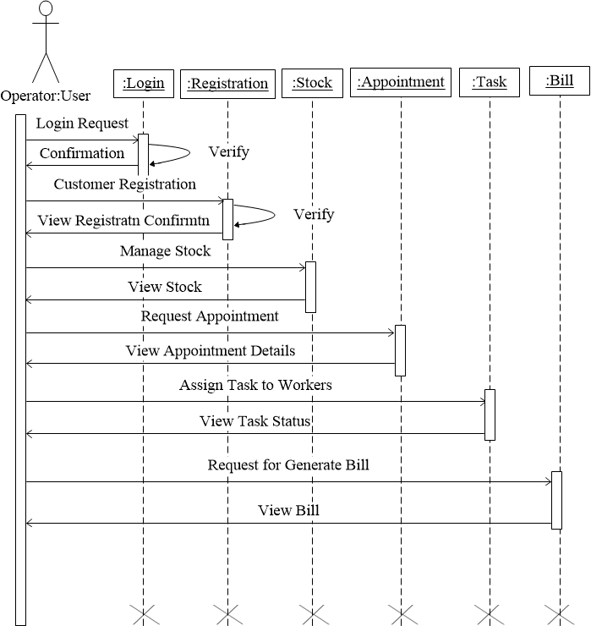
Sequence Diagram-Operator

Slide 19
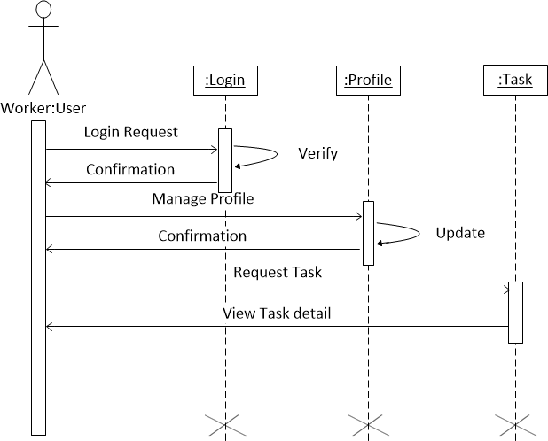
Sequence Diagram-Workers

Slide 20
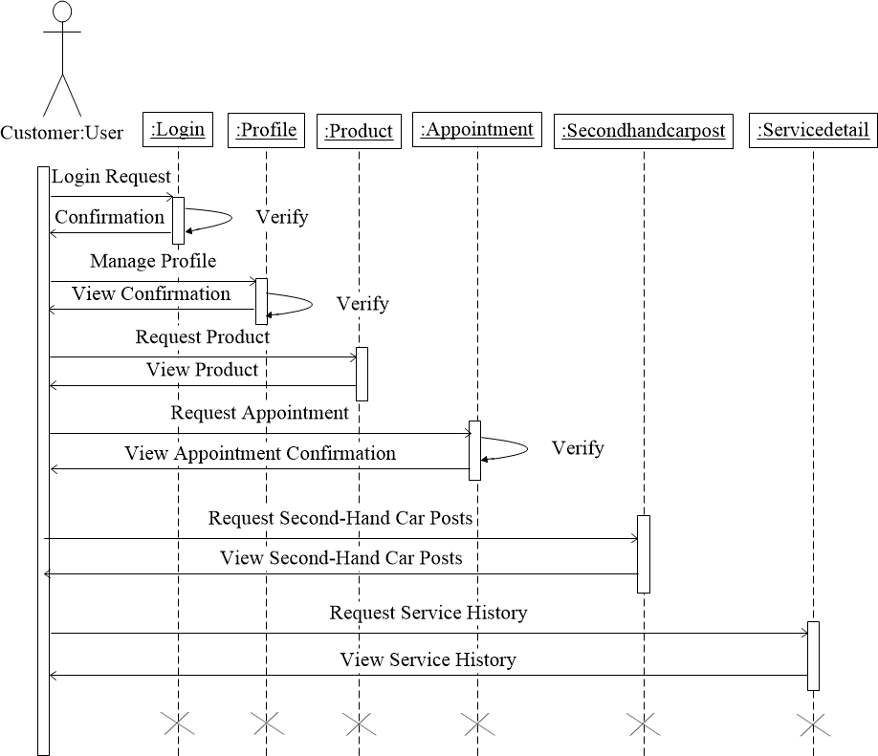
Sequence Diagram-Customer

Slide 21
Data Dictionary
Vehicle
Table Name | Vehicle
Primary key | Vid
Description | This table stores vehicle name and it’s photo.
NO | Filed Name | Data Type | Size | Constraint | Description
1. | Vid | Int | - | Primary key | Define unique Vehicle id
2. | Vname | Varchar | 20 | Not Null | This field stores Vehicle name.
3. | Vimg | Varchar | 50 | Not Null | This field stores Vehicle image.
4. | IsDisplay | Bit | - | NotNull | Defines to show previous data or not. And stored 0 or 1 values.

Slide 22
Data Dictionary
Product
Table Name | Product
Primary key | Pid
Description | This table stores Product name and it’s photo.
NO | Filed Name | Data Type | Size | Constraint | Description
1. | Pid | Int | - | Primary key | Define unique Product id
2. | Pname | Varchar | 20 | Not Null | This field stores Product name.
3. | Pimg | Varchar | 50 | Not Null | This field stores Product image.
4. | IsDisplay | Bit | - | NotNull | Defines to show previous data or not. And stored 0 or 1 values.

Slide 23
Data Dictionary
VehicleType_Product
Table Name | VehicleType_Product
Primary key | VTypeProd_id
Foreign Key | Vid (Table:- Vehicle)
Foreign Key | Pid (Table:- Product)
Description | This table stores Vehicle Type Product details.
NO | Filed Name | Data Type | Size | Constraint | Description
1. | VTypeProd_id | Int | - | Primary Key | Defines unique Vehicle type product Id.
2. | Pid | Int | - | Foreign Key | This field stores Product Id as foreign key from Product table.
3. | Vid | Int | - | Foreign Key | This field stores Vehicle Id as foreign key from Vehicle table.
4. | VProPrice | Int | - | Not Null | This field stores the Vehicle product price.

Slide 24
Data Dictionary
Area
Table Name | Area
Primary key | Areaid
Description | This table stores Area name.
NO | Filed Name | Data Type | Size | Constraint | Description
1. | Areaid | Int | - | Primary key | Define unique Area id.
2. | Areaname | Varchar | 20 | Not Null | Define Area name.

Slide 25
Data Dictionary
Designation
Table Name | Designation
Primary key | Did
Description | This table stores designation name.
NO | Filed Name | Data Type | Size | Constraint | Description
1. | Did | Int | - | Primary key | Define unique Designation ID.
2. | Dname | Varchar | 20 | Not Null | Define Designation name.

Slide 26
Data Dictionary
User
Table Name | User
Primary key | Userid
Foreign Key | Did (Table:- Designation)
Foreign Key | Areaid (Table:- Area)
Description | This table stores user detail.
NO | Filed Name | Data Type | Size | Constraint | Description
1. | Userid | Int | - | Primary key | The unique ID no. assigned to all Users (auto incremented).
2. | Did | Int | - | Foreign key | This field stores Designation Id as foreign key from Designation table.
3. | Fname | Varchar | 20 | Not Null | This field stores First Name.
4. | Lname | Varchar | 20 | Not Null | This field stores Last Name.
5. | Address | Varchar | 50 | Not Null | This field stores Address.
6. | ContactNo | Varchar | 13 | Not Null | Defines contact No.

Slide 27
NO | Filed Name | Data Type | Size | Constraint | Description
7. | PostalCode | Int | 6 | Not Null | Defines Postal Code.
8. | Areaid | Int | - | Foreign key | This field stores Area Id as foreign key from Area table.
9. | Email | Varchar | 30 | Unique Key | Defines contact No.
10. | Username | Varchar | 20 | Not Null | Specifies the username.
11. | Password | Varchar | 20 | Not Null | Sets the password.
12. | DOB | Date | - | Not Null | Stores Date of Birth.
13. | Userimg | Varchar | 50 | Not Null | Defines User Image.
14. | IsAuth | Bit | - | Not Null | This field stores the authentication of Users.

Slide 28
Data Dictionary
Stock
Table Name | Stock
Primary key | Sid
Foreign Key | VTypeProd_id (Table:- VehicleType_Product)
Description | This table stores Stock detail.
NO | Filed Name | Data Type | Size | Constraint | Description
1. | Sid | Int | - | Primary Key | Defines the unique Stock Id.
2. | VTypeProd_id | Int | - | Foreign Key | This field stores Vehicle type product Id as foreign key from Vehicle type product table.
3. | Sdescription | Varchar | 50 | Not Null | This field stores Stock description.
4. | Sdate | Date | - | Not Null | This field stores when the entry done of stock.

Slide 29
5. | Squantity | Int | - | Not Null | This field stores the quantity of Stock.
6. | InOutward | Int | - | Not Null | To store Stock In or Out (1 as a In and 2 as a Out)

Slide 30
Data Dictionary
VehicleNumber
Table Name | VehicleNumber
Primary key | Vnumberid
Foreign Key | Userid (Table:- User) Vid (Table:- Vehicle)
Description | This table stores user wise vehicle details.
NO | Filed Name | Data Type | Size | Constraint | Description
1. | Vnumberid | Int | - | Primary Key | Defines the unique vehicle number Id.
2. | Userid | Int | - | Foreign Key | This field stores User Id as foreign key from User table.
3. | Vnumber | Varchar | 10 | Not Null | This field stores Vehicle number.
4. | Vid | Int | - | Foreign Key | This field stores Vehicle Id as foreign key from Vehicle table.

Slide 31
Data Dictionary
Service
Table Name | Service
Primary key | Sid
Foreign Key | Vnumberid (Table:-VehicleNumber) Userid (Table:-User)
Description | This table stores Service detail.
NO | Filed Name | Data Type | Size | Constraint | Description
1. | Sid | Int | - | Primary Key | Defines the unique Service Id.
2. | Sdescription | Varchar | 250 | Not Null | This field stores Description of Service.
3. | Vnumberid | Int | - | Foreign Key | This field stores Vehicle Number Id as foreign key from Vehicle Number table.
4. | Userid | Int | - | Foreign Key | This field stores User Id as foreign key from User table.
5. | IsDone | Bit | - | Not Null | To Check that Service is Done or Not.

Slide 32
6. | Aregistereddate | Date | - | Not Null | This field stores Appointment Registered Date.
7. | Aservicedate | Date | - | Not Null | This field stores Appointment Service Date.

Slide 33
Data Dictionary
ServiceDetail
Table Name | ServiceDetail
Primary key | Sdetailid
Foreign Key | Sid (Table:-Service) VTypeProd_id (Table:- VehicleType_Product)
Description | This table stores Service details.
NO | Filed Name | Data Type | Size | Constraint | Description
1. | Sdetailid | Int | - | Primary Key | Defines the unique Service detail Id.
2. | Sid | Int | - | Foreign Key | This field stores Service Id as foreign key from Service table.
3. | VTypeProd_id | Int | - | Foreign Key | This field stores Vehicle type product Id as foreign key from Vehicle type product table.

Slide 34
4. | Sdescription | Varchar | 50 | Not Null | This field stores Service description.
5. | Price | Int | - | Not Null | This field stores Price of Particular Vehicle’s Product Price.
6. | Quantity | Int | - | Not Null | This field stores Quantity of Product.

Slide 35
Data Dictionary
PackageType
Table Name | PackageType
Primary key | Packtid
Description | This table stores Package details.
NO | Filed Name | Data Type | Size | Constraint | Description
1 | Packtid | Int | - | Primary Key | Defines the unique Package Type Id.
2 | Packname | Varchar | 20 | Not Null | This field stores Package Type Name.
3 | Packamt | Int | - | Not Null | This field stores the Package type Amount.
4 | Packimg | Varchar | 50 | Not Null | Display image of Different Package type.

Slide 36
Data Dictionary
PackageDetail
Table Name | PackageDetail
Primary key | Pdid
Foreign Key | Userid (Table:- User) Packtid (Table:- PackageType)
Description | This table stores Package detail user wise.
NO | Filed Name | Data Type | Size | Constraint | Description
1 | Pdid | Int | - | Primary Key | Defines the unique Package detail Id.
2 | Userid | Int | - | Foreign Key | This field stores User Id as foreign key from User table.
3 | Packtid | Int | - | Foreign Key | This field stores Package Id as foreign key from Package table.
4. | DOS | Date | - | Not Null | This field stores Recharge starts on which date.
5. | DOF | Date | - | Not Null | This field stores Recharge end on which date.

Slide 37
Data Dictionary
Feedback
Table Name | Feedback
Primary key | Fid
Foreign Key | Userid (Table:- User)
Description | This table stores Feedback detail.
NO | Filed Name | Data Type | Size | Constraint | Description
1 | Fid | Int | - | Primary Key | Defines the unique Feedback Id.
2 | Feedback | Varchar | 250 | Not Null | This field stores Customer’s Feedback.
3 | DOF | Date | - | Not Null | This field stores Date of Feedback.
4 | Userid | Int | - | Foreign Key | This field stores User Id as foreign key from User table.

Slide 38
Data Dictionary
Secondcar_Post
Table Name | Secondcar_Post
Primary key | Carid
Foreign Key | Vid (Table:- Vehicle)
Description | This table stores Second-hand Car details.
NO | Filed Name | Data Type | Size | Constraint | Description
1 | Carid | Int | - | Primary Key | Define the Unique Car Id.
2 | Vid | Int | _ | Foreign Key | This field stored VId as foreign key from Vehicle Table.
3 | CarImg | Varchar | 50 | Not Null | This field stores Car image.
4 | Cardesp | Varchar | 250 | Not Null | This field stores Car description.
5 | DOP | Date | - | Not Null | This field stores date of Second-Hand car post.
6. | KM | Int | - | Not Null | This field stores Car KM till post.

Slide 39
NO | Filed Name | Data Type | Size | Constraint | Description
7. | IsDr | Bit | - | Not Null | To store car owner is Dr or Not .
8. | Price | Int | - | Not Null | This field stores Car price.
9. | IsNegotiable | Bit | - | Not Null | To store car price is Negotiable or Not.
10. | Modelno | Int | - | Not Null | This field stores Car model no.
11. | Year | Date | - | Not Null | This field stores Car year.
12. | IsFirstOwner | Bit | - | Not Null | Define the Car owner.
13. | Fueltype | Varchar | 20 | Not Null | This field stores Car fuel type.
14. | Carcolour | Varchar | 20 | Not Null | This field stores Car colour.
15. | Withpolicy | Bit | - | Not Null | This field stores Car is with Policy or Not.
16. | IsDisplay | Bit | _ | Not Null | This field stores Car display or not.

Slide 40
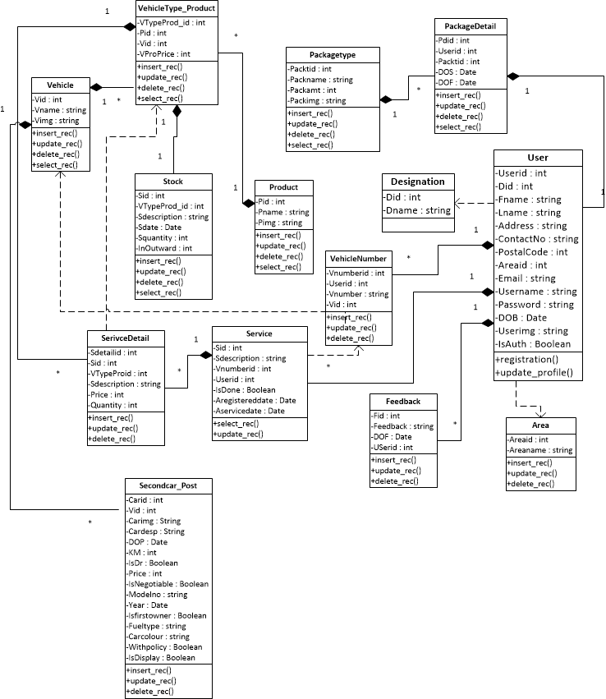
Class Diagram

Slide 41





Process Description
User Management
Task Allocation
Stock Usage
Task Status
Manage Feedback

Slide 42
Process Description cont..
User Management:-
Registration:- Registration of operator and workers, and they can manage by admin.
Registration of Customers, and they can manage by operator.
Login:- Login should be done by admin, operator, worker and customer.
Task Allocation:-
Operator can assign task to workers as per customer appointments.
Task Status:-
All Tasks status manage in this system.
Stock Usage:-
View status of Stock available or not.
Helpdesk Management:-
a) Log Complain.
b) Reporting.

Slide 43
Process Algorithm (Admin Side)
Step 1:
Start
Step 2:
Fill up name & password. If invalid name and Password then again go to setp2. Otherwise go to step3.
Step 3:
Manage Operator & Workers.
Manage Vehicle, Product , Vehicle Product Price , Service Packages & Second-Hand car posts..
Step 4:
Manage Feedback.
Step 5 :
Stop

Slide 44
Process Algorithm (Operator Side)
Step 1:
Start
Step 2:
Fill up name & password. If invalid name and Password then again go to setp2. Otherwise go to step3.
Step 3:
Manage Customer.
Manage Appointment, Stock , Worker’s Task Sheet.
Step 4:
Generate Bill.
Step 5 :
Stop

Slide 45
Process Algorithm (Worker Side)
Step 1:
Start
Step 2:
Fill up name & password. If invalid name and Password then again go to setp2. Otherwise go to step3.
Step 3:
Manage Task Sheet.
Step 4:
Stop.

Slide 46
Process Algorithm (Customer Side)
Step 1:
Start
Step 2:
Fill up User name and Password. If invalid User name and Password then again go to setp2.
Otherwise go to Sep3.
Step 3:
Different Searching facility.(Like Product, Service Package, Second-Hand Car Posts etc.)
Step 4:
Book Appointment And/or Select Accessories.
Give feedback and View Service History.
Step 5 :
Stop.

Slide 47
Admin
Input / Output Design

Slide 48
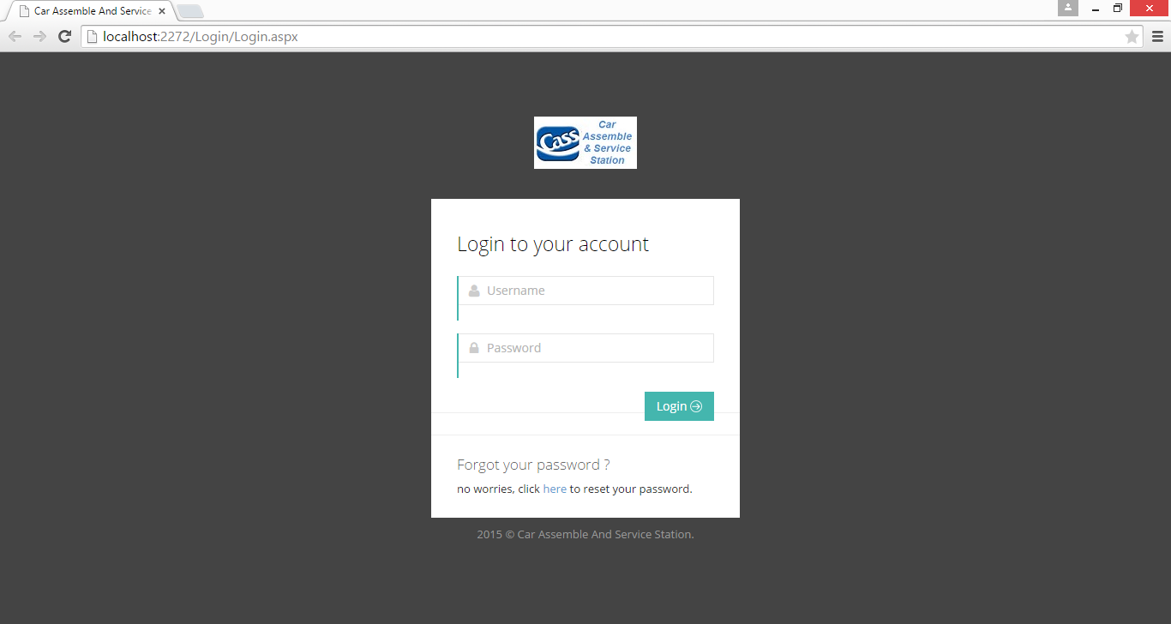
Login Page
Description: This is Sign-in Page; Here Admin can sign-in into site.

Slide 49
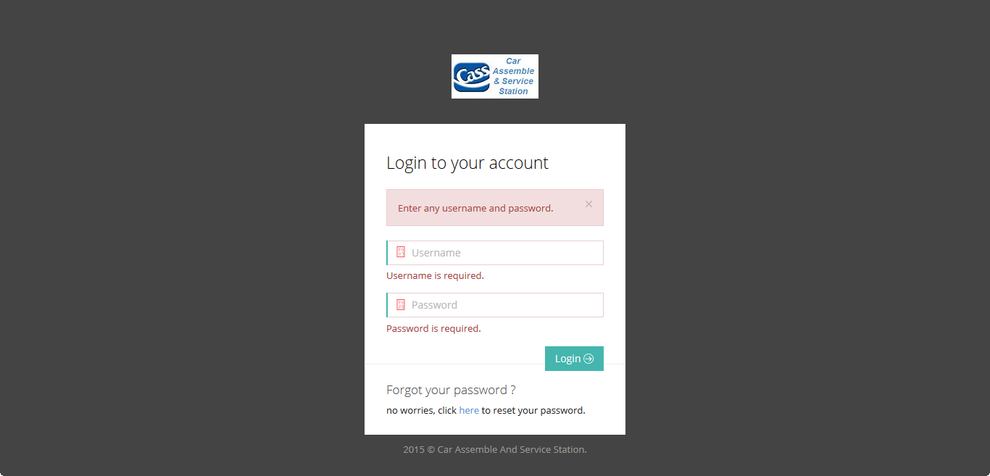
Validation Login
Description: This is Login Page, Here Validation occurs when fields are not filled.

Slide 50

Login Page
Description: Admin Login page, Here Admin can enter his valid email-id & password and login into site.

Slide 51
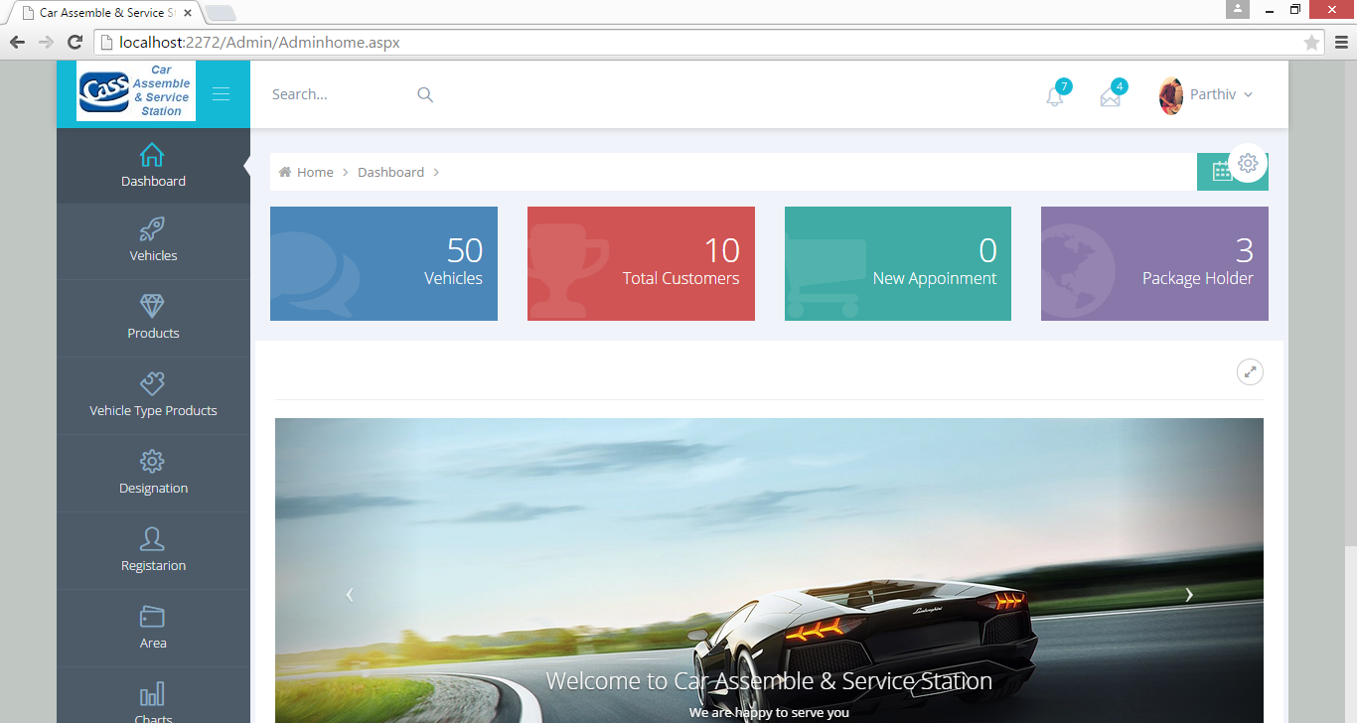
Home Page
Description: Admin home page

Slide 52
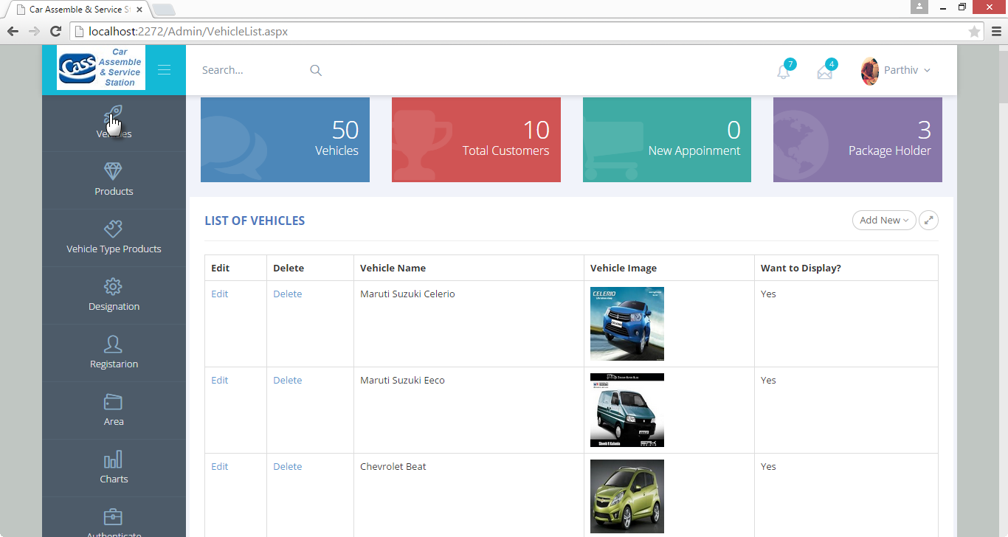
Vehicle Page
Description: This is a Vehicle Page, Here Admin can manage particular Vehicle.

Slide 53
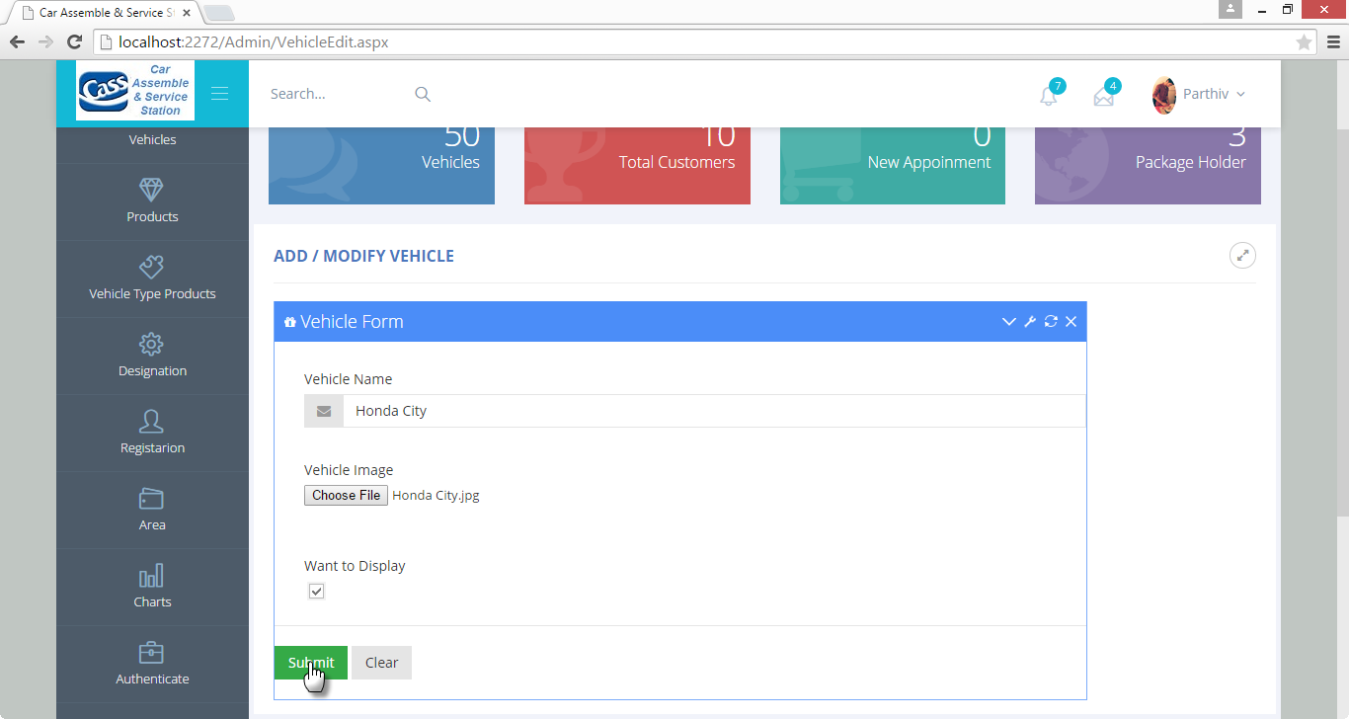
Insert Vehicle Page
Description: This is a Vehicle Page, Here Admin can insert a new Vehicle.

Slide 54
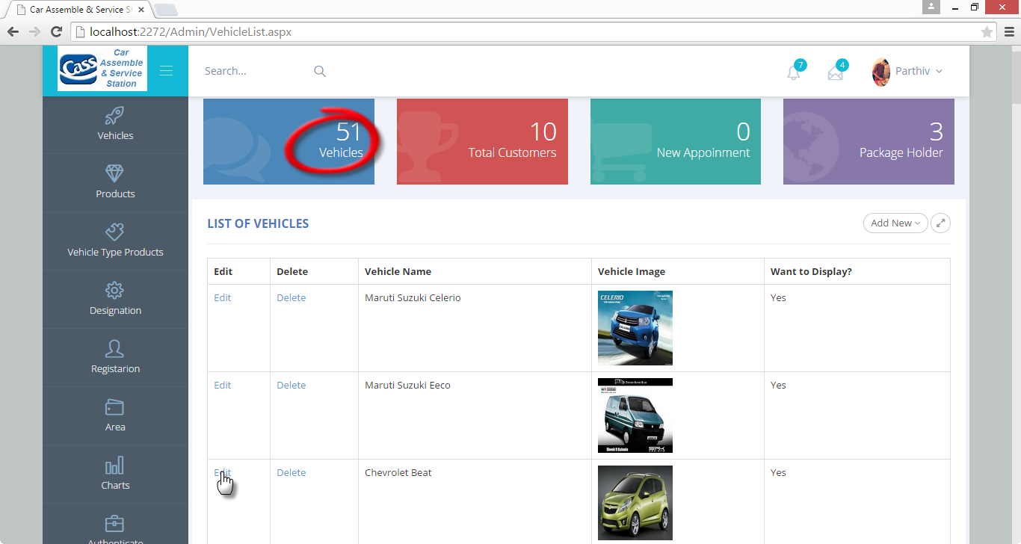
Vehicle Page
Description: This is a Vehicle Page, Here Admin can edit particular Vehicle from the List of Vehicles.

Slide 55
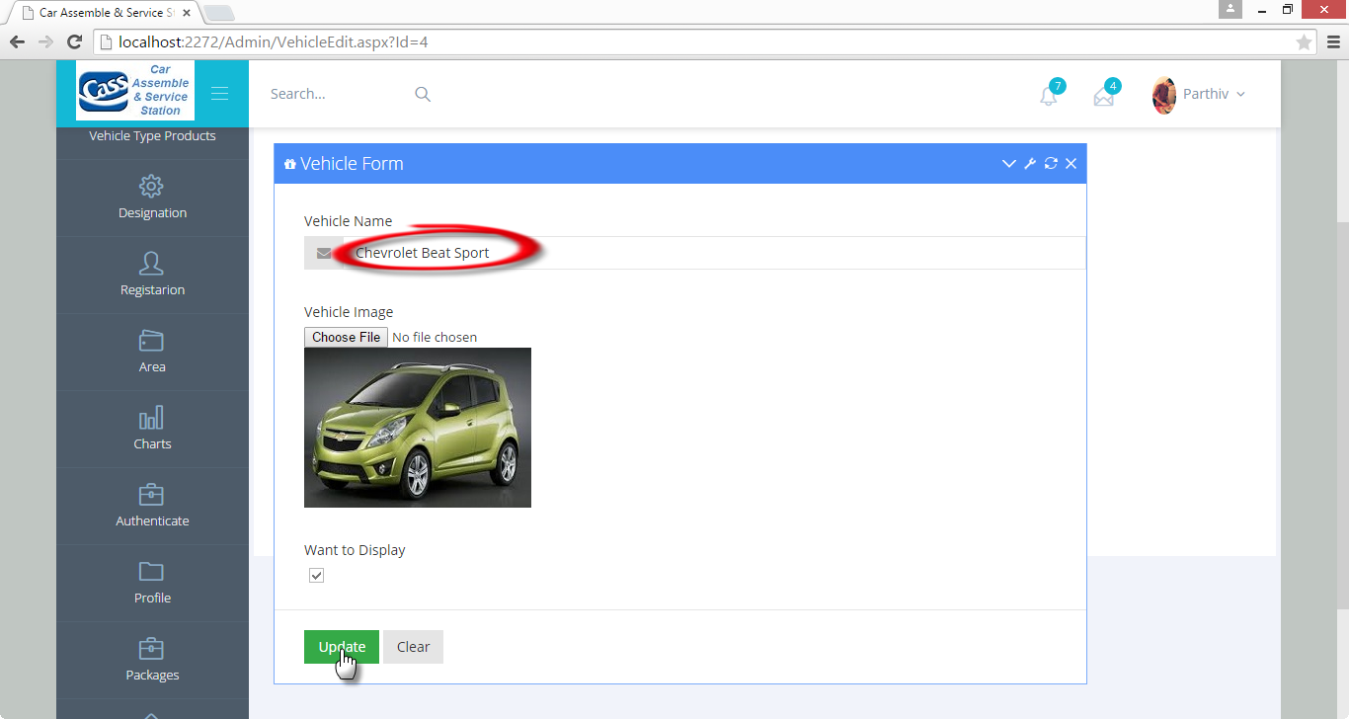
Update Vehicle Page
Description: This is a Vehicle Page, Here Admin can update particular from the List of Vehicles.

Slide 56
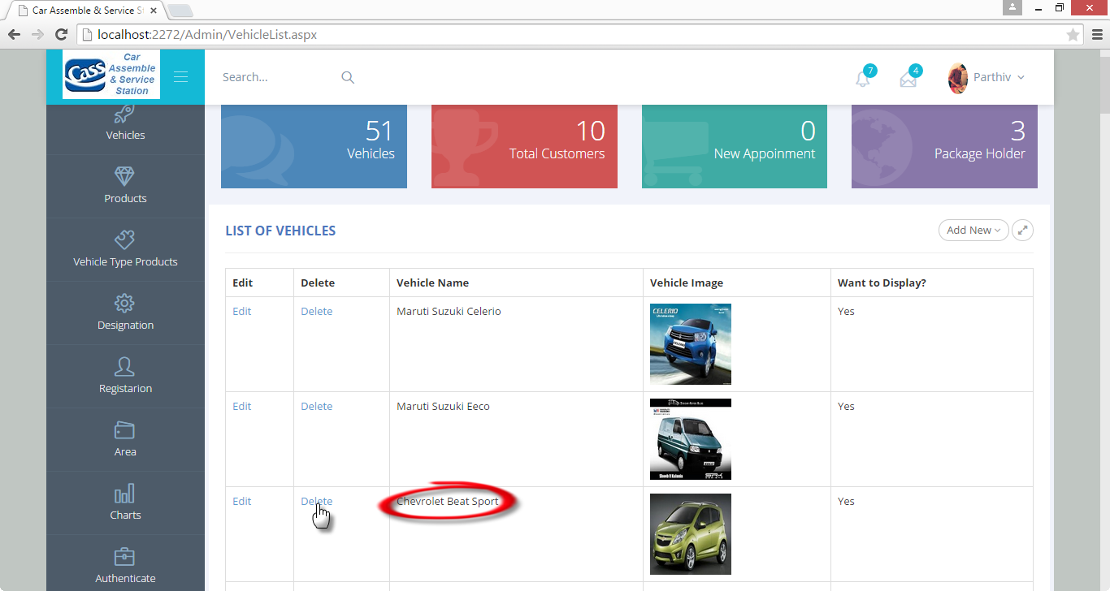
Vehicle Page
Description: This is Vehicle Page, Here Admin can delete particular Vehicle from the List of Vehicles.

Slide 57
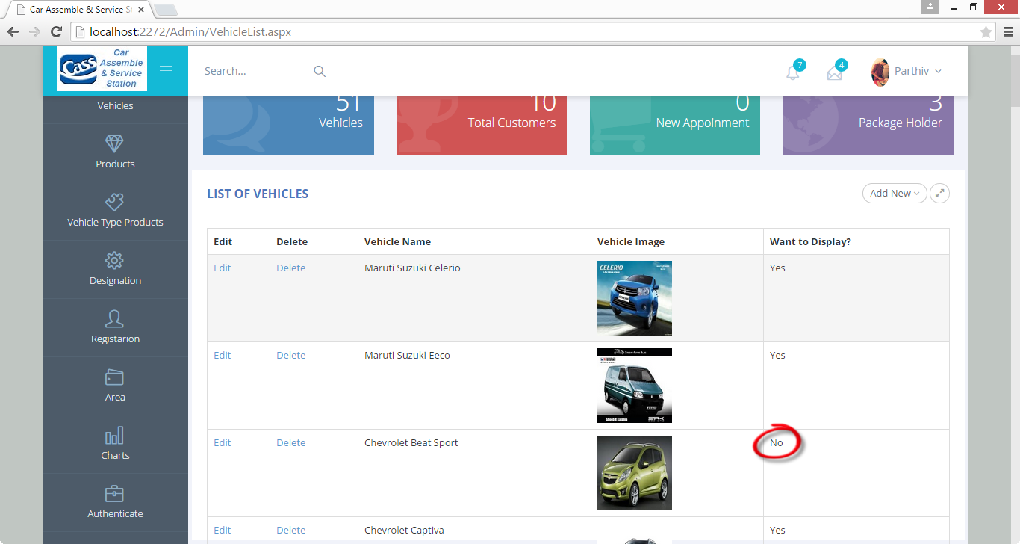
Vehicle Page After Performing Operations
Description: This is a Vehicle Page, Here Admin can see the Vehicle list after performing Insert, Update and Delete Operations.

Slide 58
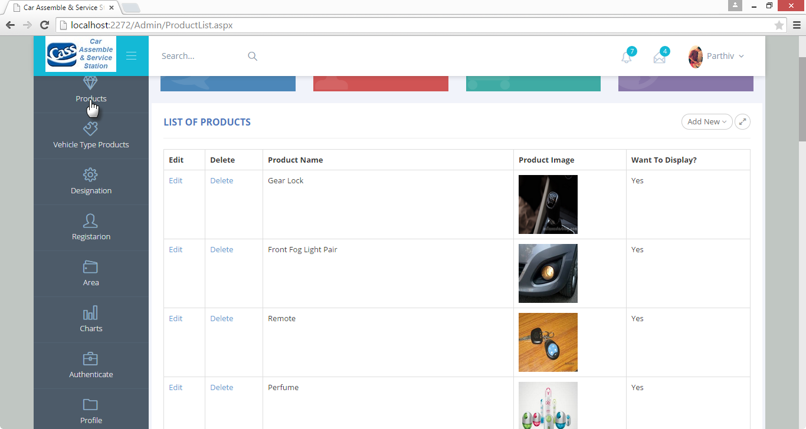
Product Page
Description: This is a Product Page; Here Admin can manage particular Product.

Slide 59
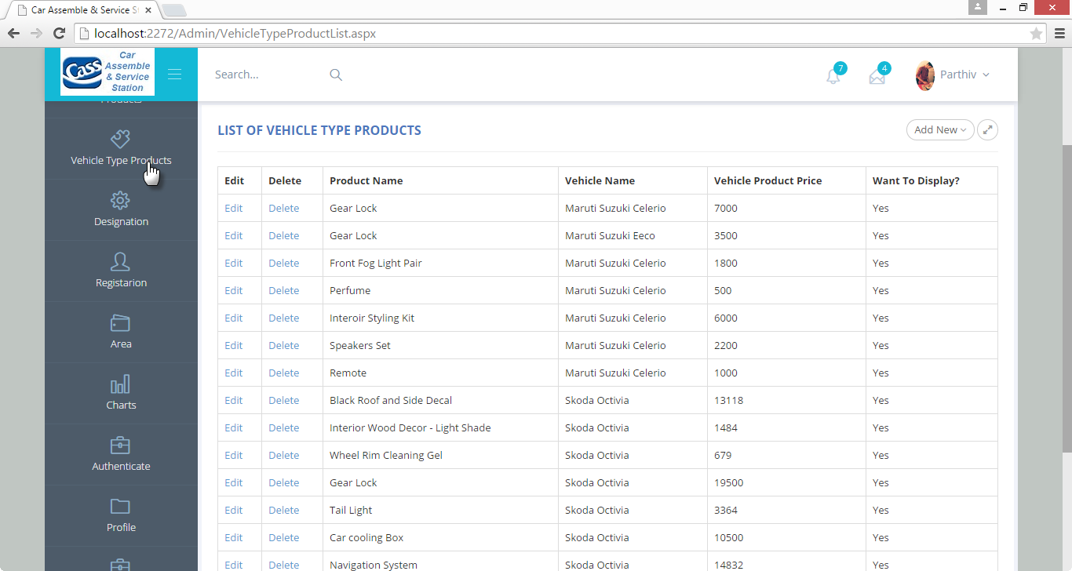
Vehicle Type Product Page
Description : This is a Vehicle Type Product Page, Here Admin can Add, Update or Delete particular Vehicle Type Product with Price.

Slide 60
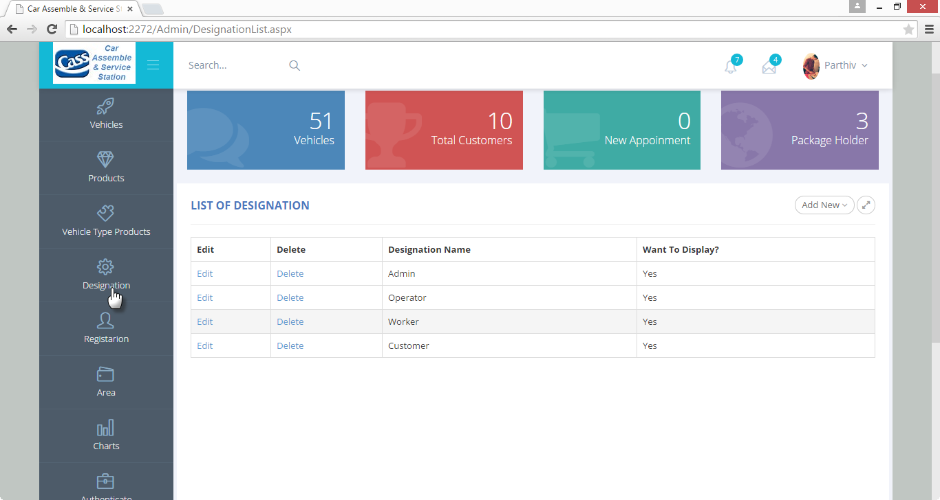
List of Designation Page
Description : From this page, Admin can Add, Update or Delete particular Designation.

Slide 61
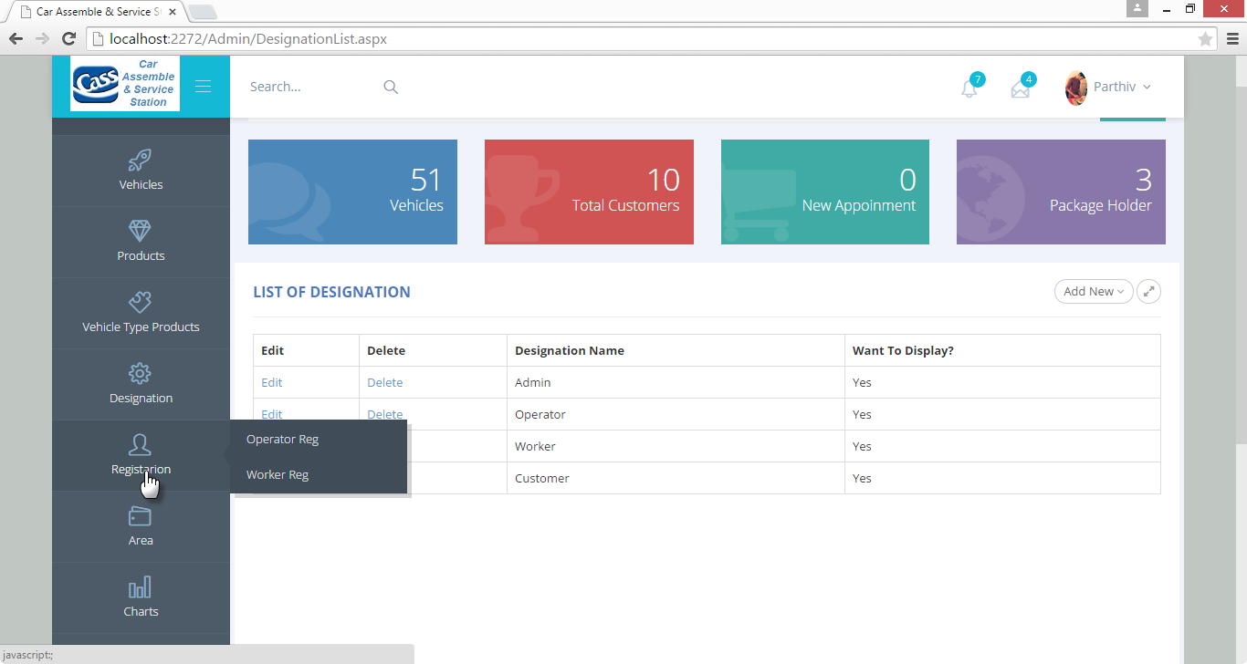
Operator And Worker Registration Page
Description : From this page,Admin can registered new Operator & Workers.

Slide 62
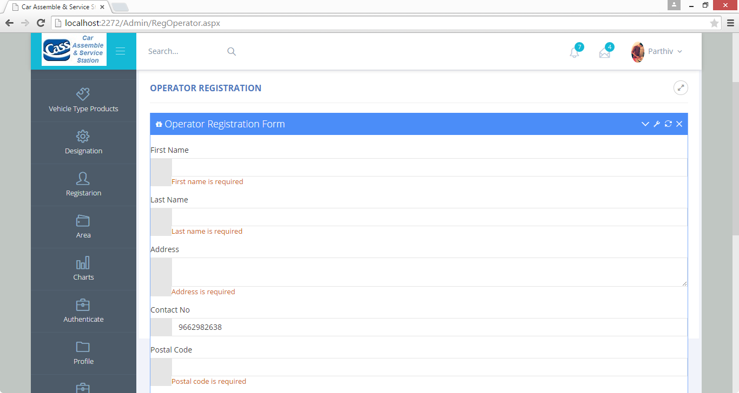
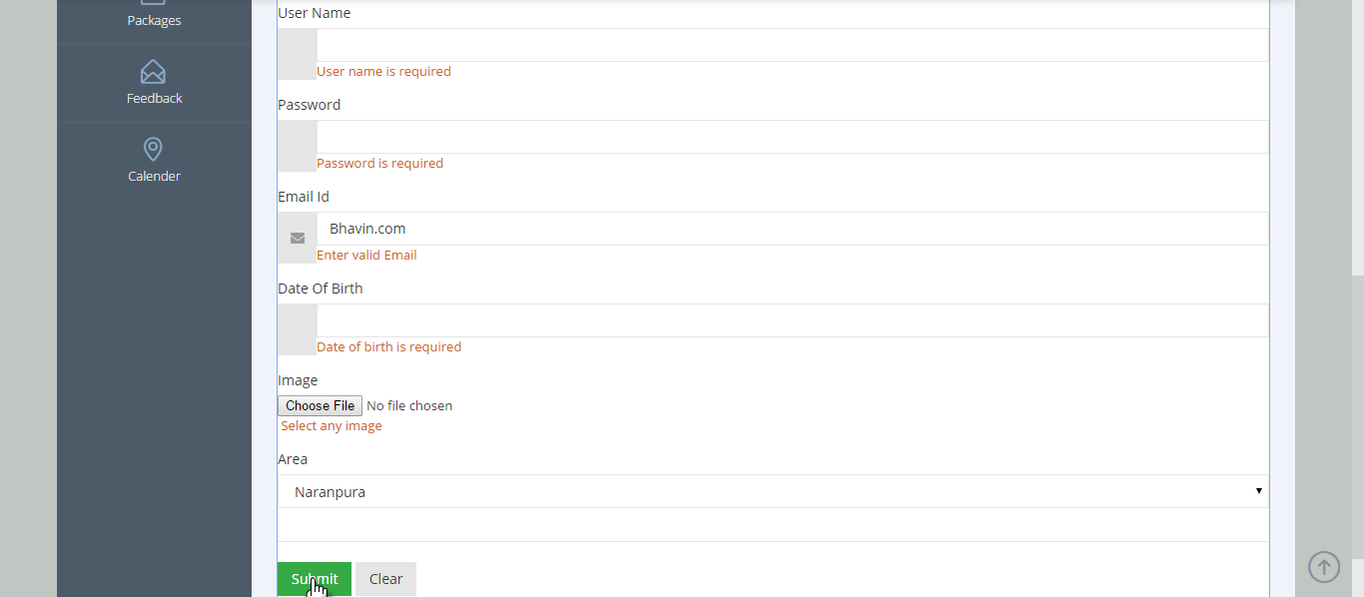
Validation Page
Description : This is Operator Registration validation Page, Here Operator have must fill required fields.

Slide 63
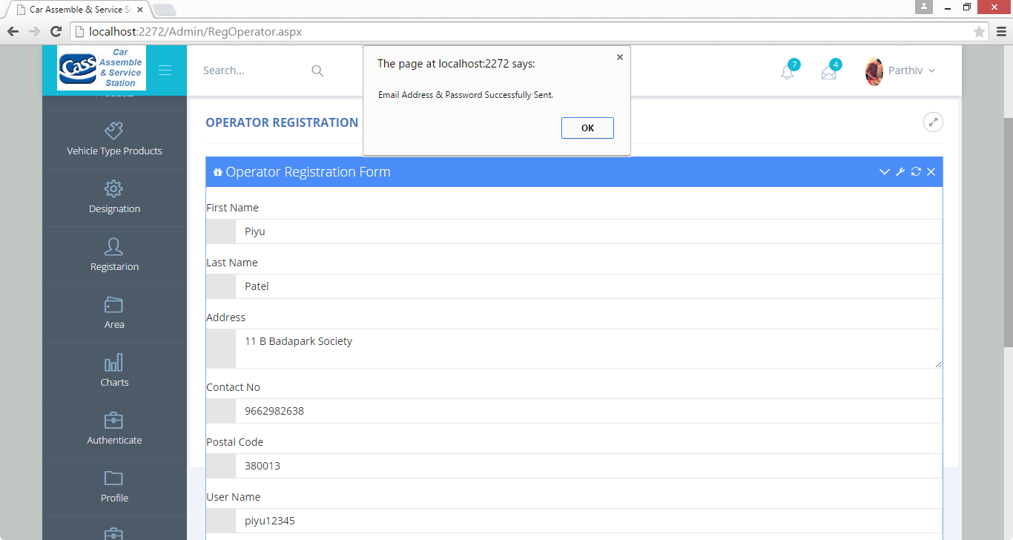
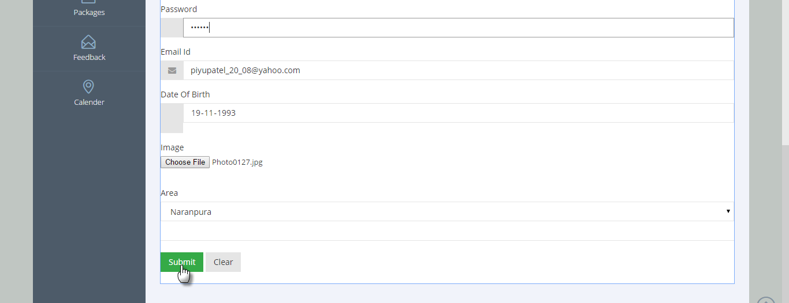
Operator Registration Page
Description : From this page,Admin can register new Operator into a site.

Slide 64
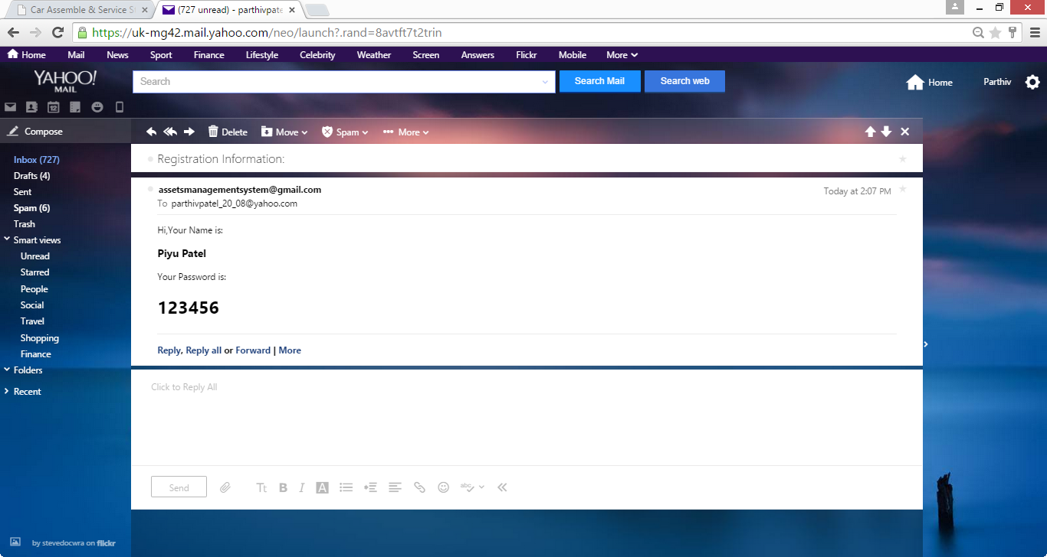
Registration Confirmation Page
Description : This is confirmation message page, Here Operator can view his/her password sent via Email

Slide 65
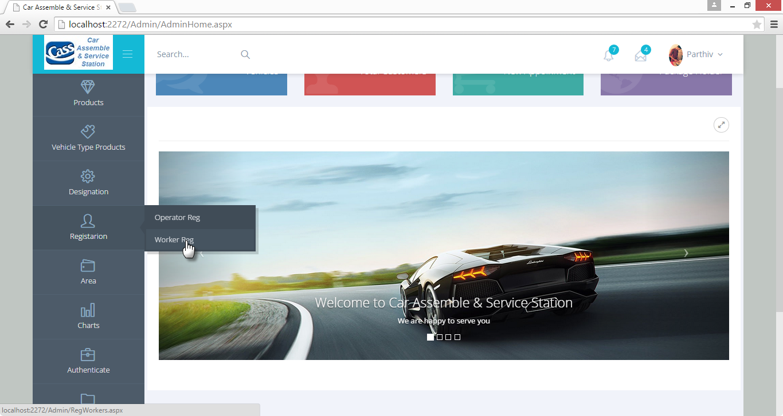
Worker Registration Page
Description : - From this page, Admin can register new Worker.

Slide 66
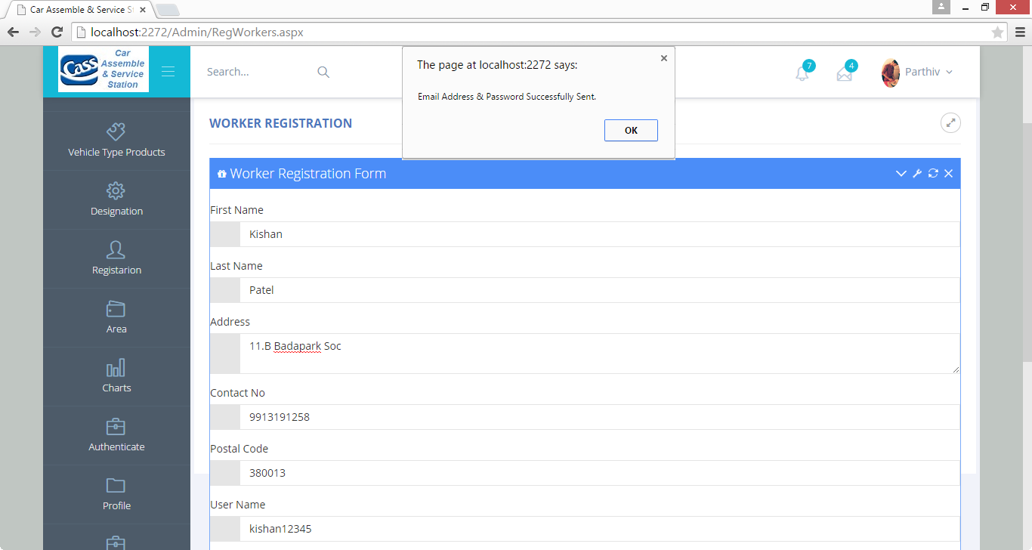
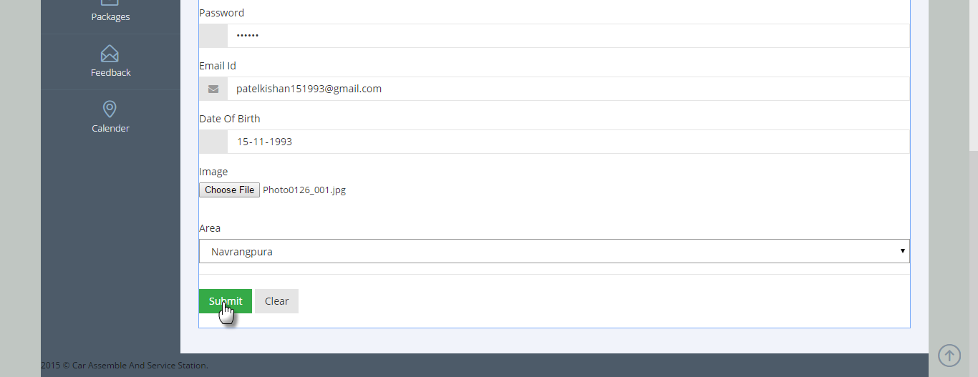
Worker Registration Page
Description : This is worker registration page, Here Admin can registered new Worker and of will automatically sent confirmation to the Worker.

Slide 67

Area Page
Description : This is Area Page, Here Admin can manage particular Area.

Slide 68
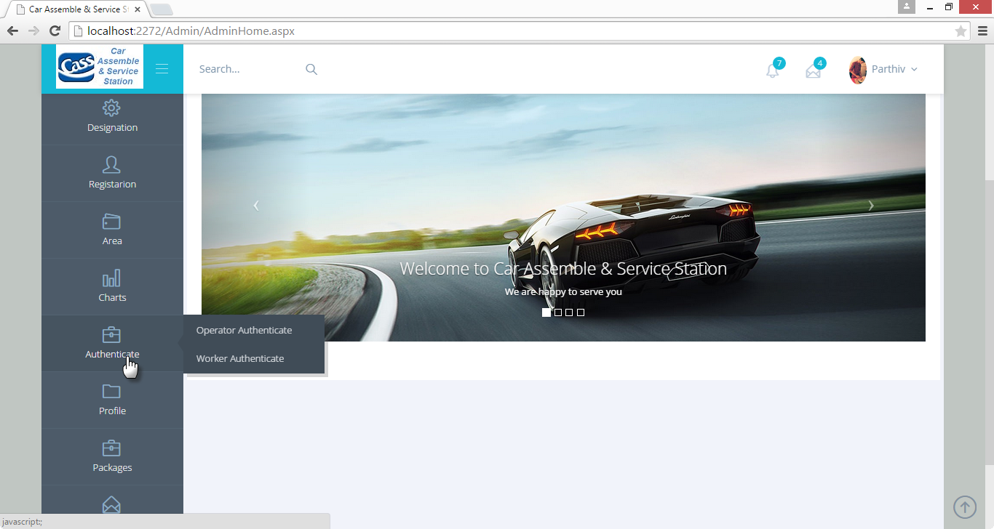
Authentication of Operator & Workers
Description : From this page, Admin can change authentication of Operator and Worker.

Slide 69
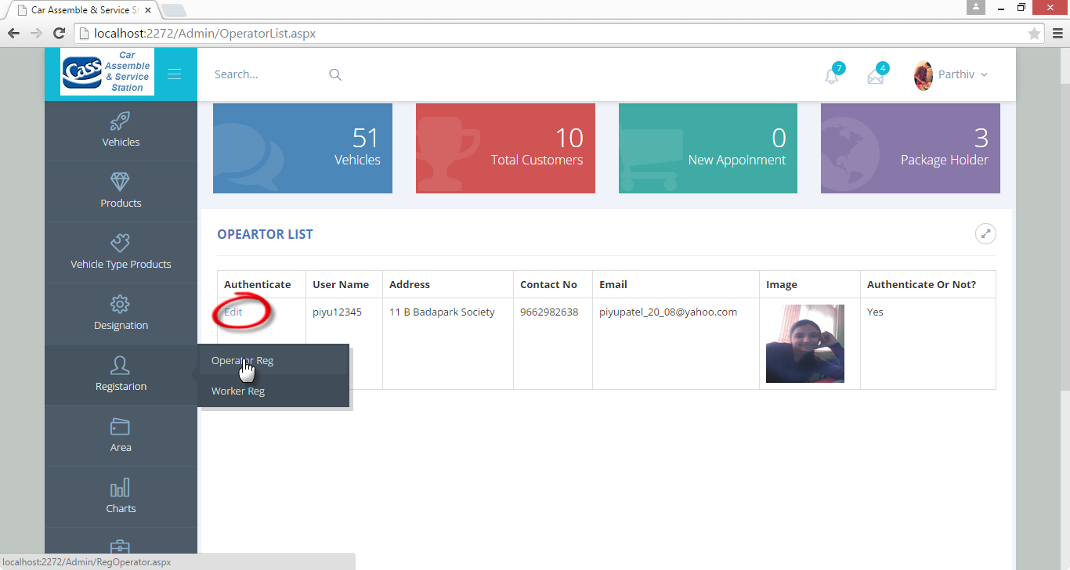
Show Operator List
Description : From this page, Here Admin can view list of Operator.

Slide 70
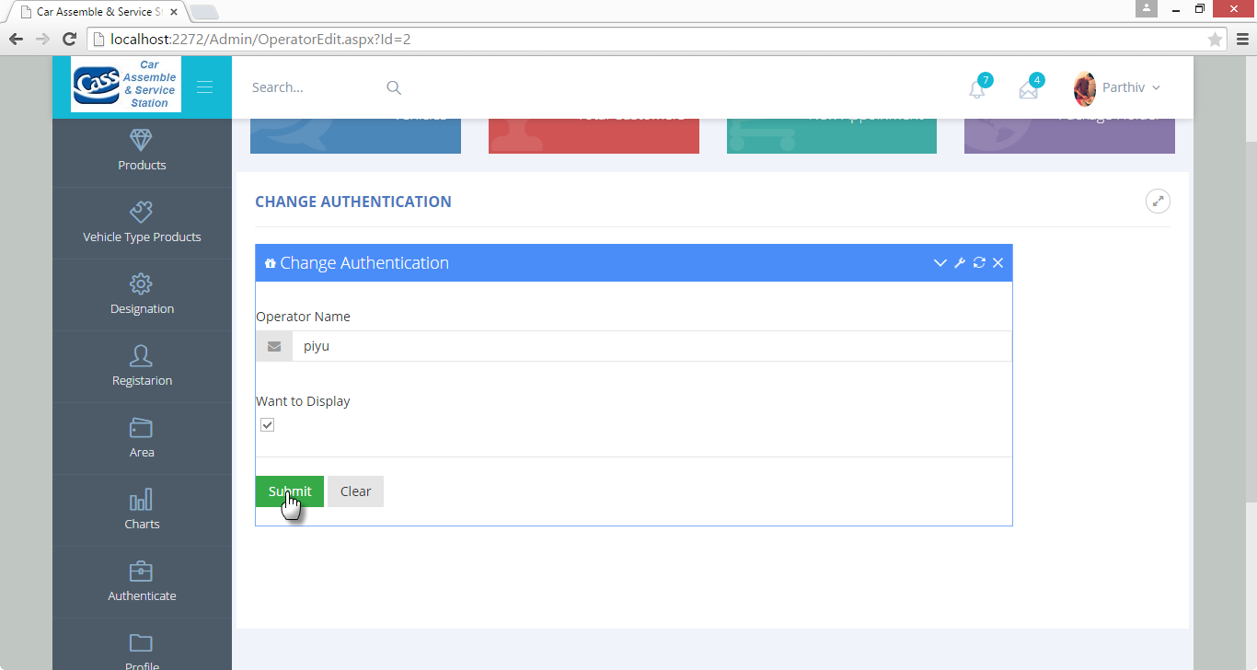
Operator Authentication
Description : From this page, Here Admin can change Authentication of particular operator.

Slide 71
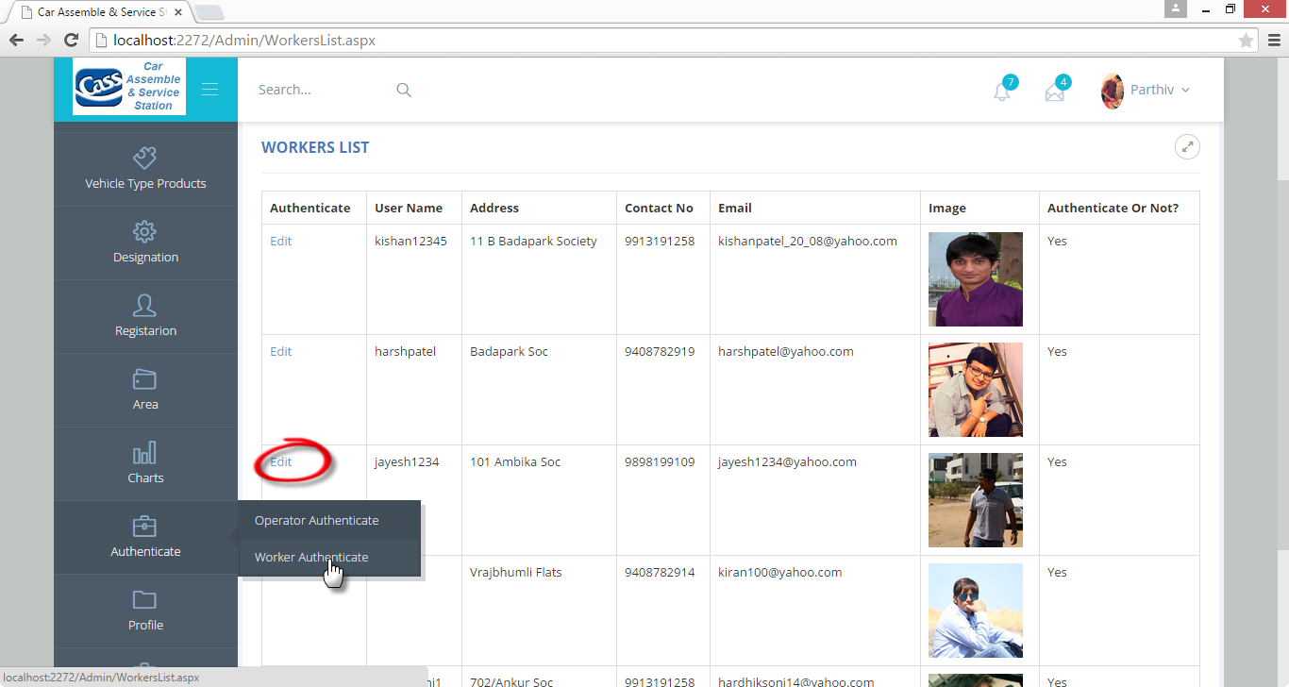
Show Workers List
Description : From this page,Admin can view list of workers registered into site.

Slide 72
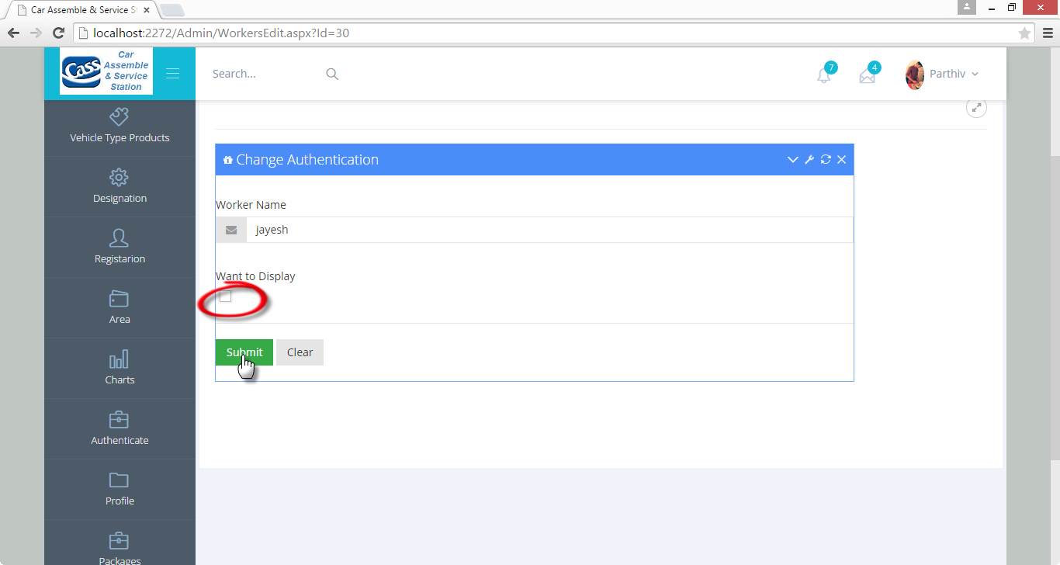
Worker Authentication
Description : From this page, Here Admin can change Authentication of particular worker.

Slide 73
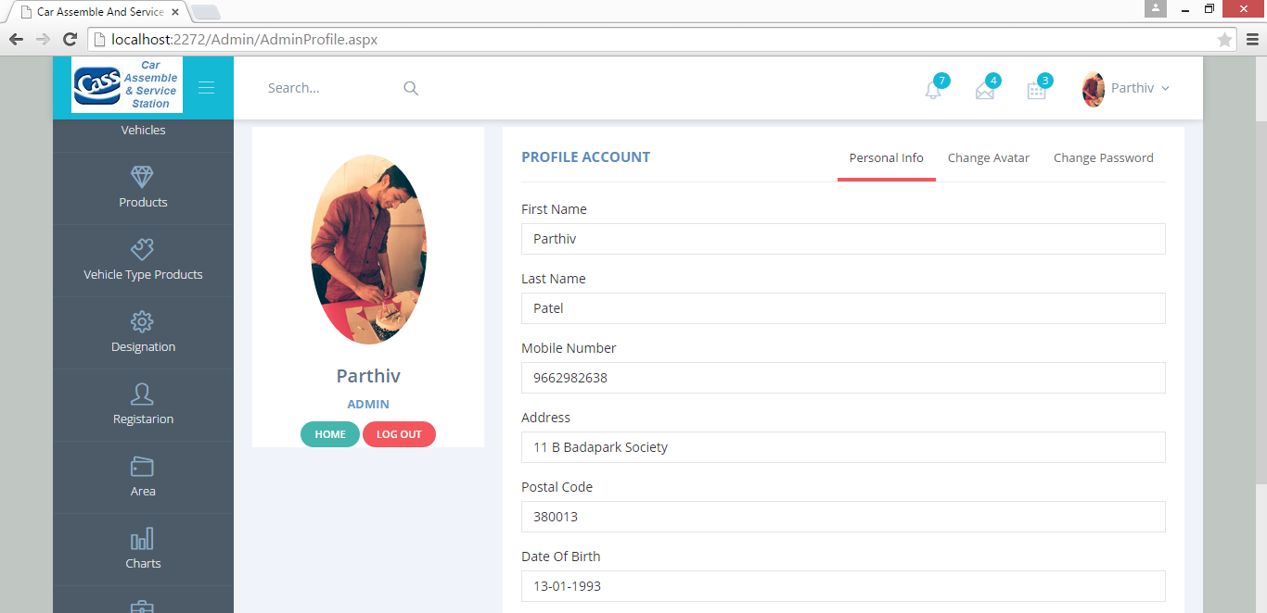
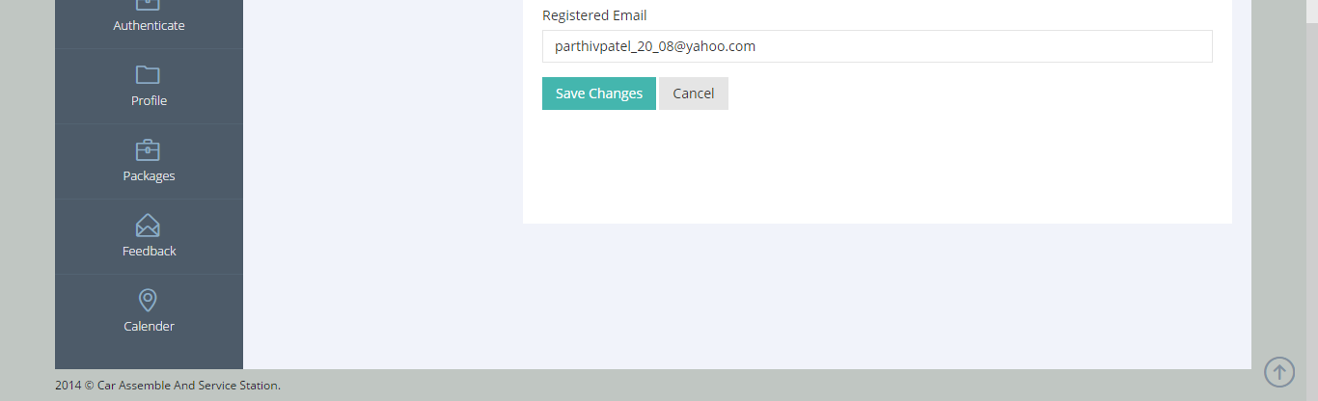
Profile Page
Description : Admin profile page. Here Admin can view his own personal details and password.

Slide 74
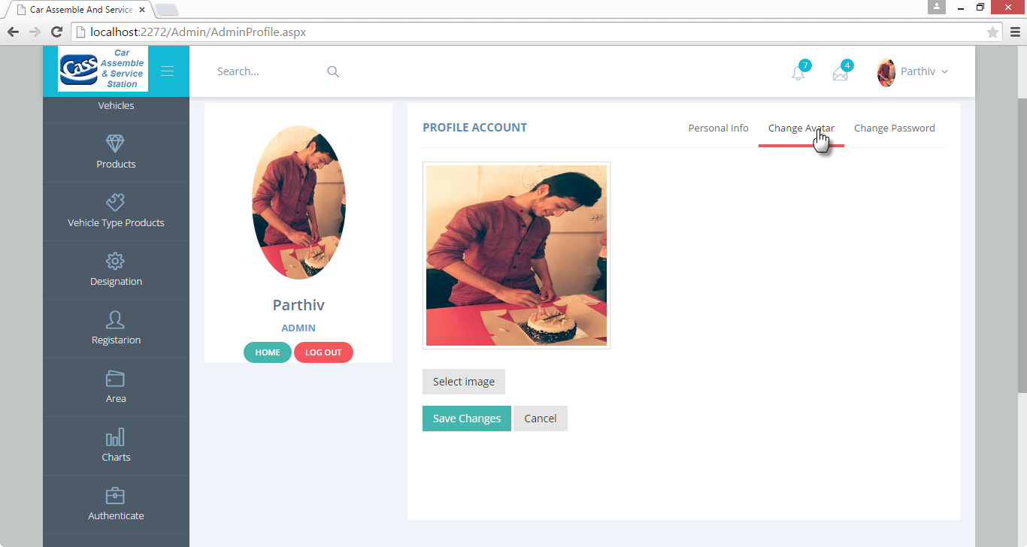
Profile Avatar Page
Description : From this page, Admin can View and change his Avatar.

Slide 75
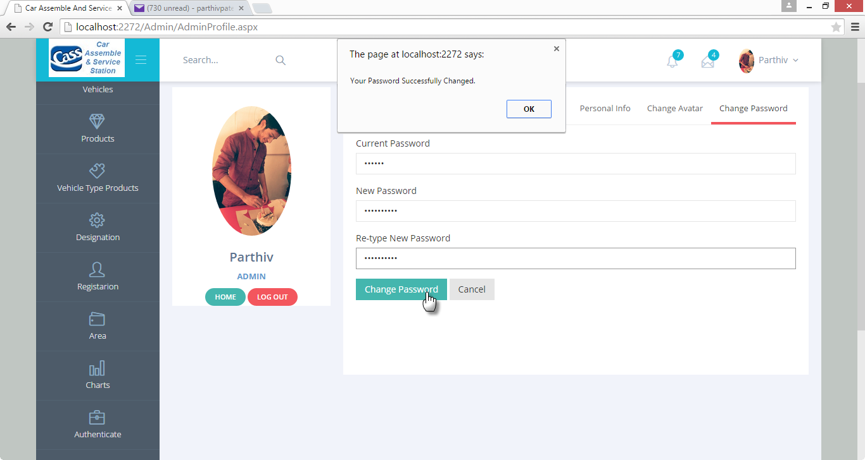
Change Password
Description : Here Admin can change his password and also get a confirmation Email of it.

Slide 76
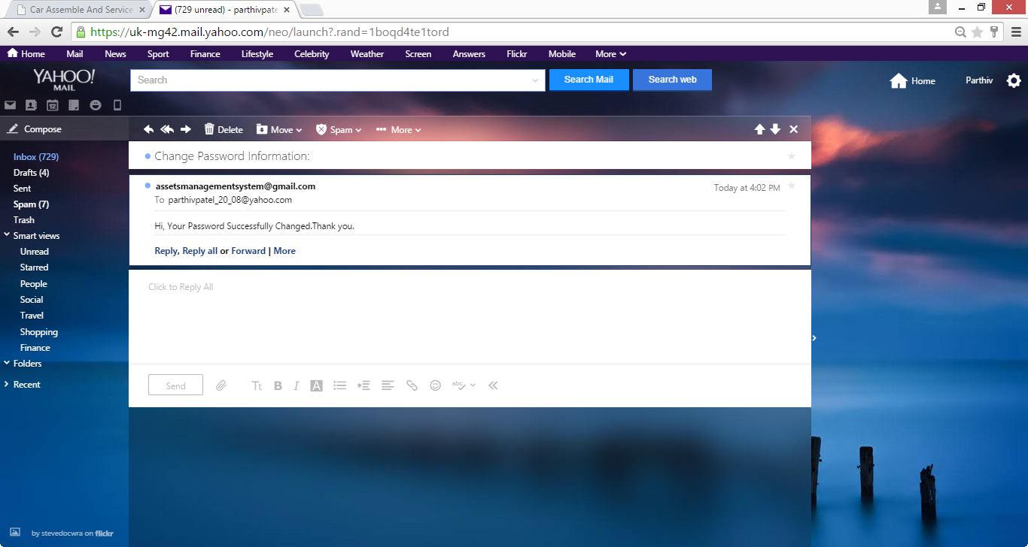
Confirmation Message Page
Description : Here Admin view his/her change password confirmation message in his/her registered mail account.

Slide 77
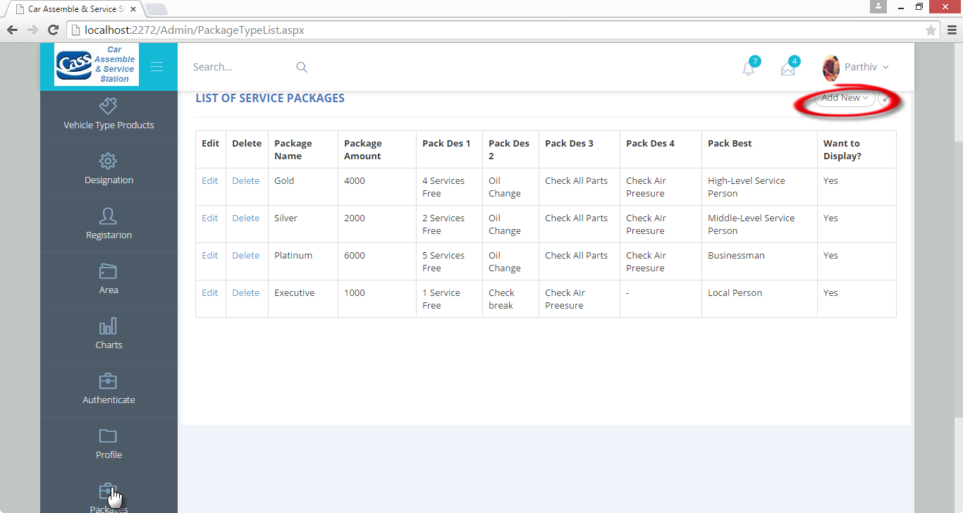
Package List Page
Description :From this page, Admin can add, update or delete particular service packages.

Slide 78
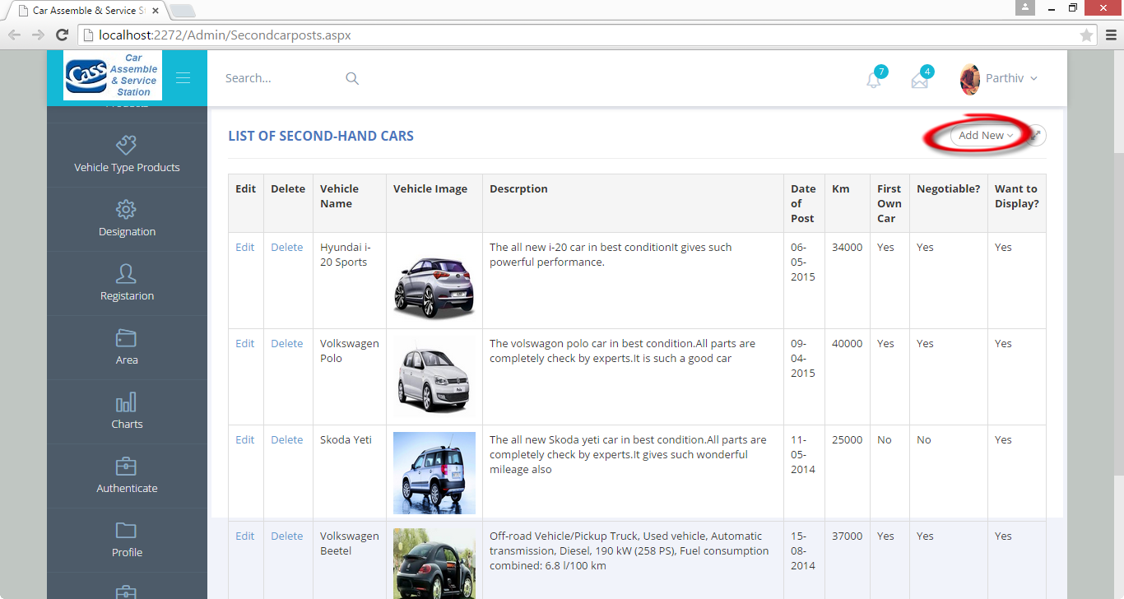
Second-Hand Car Posts
Description :From this page, Admin can add, update or delete particular Second-hand car posts..

Slide 79
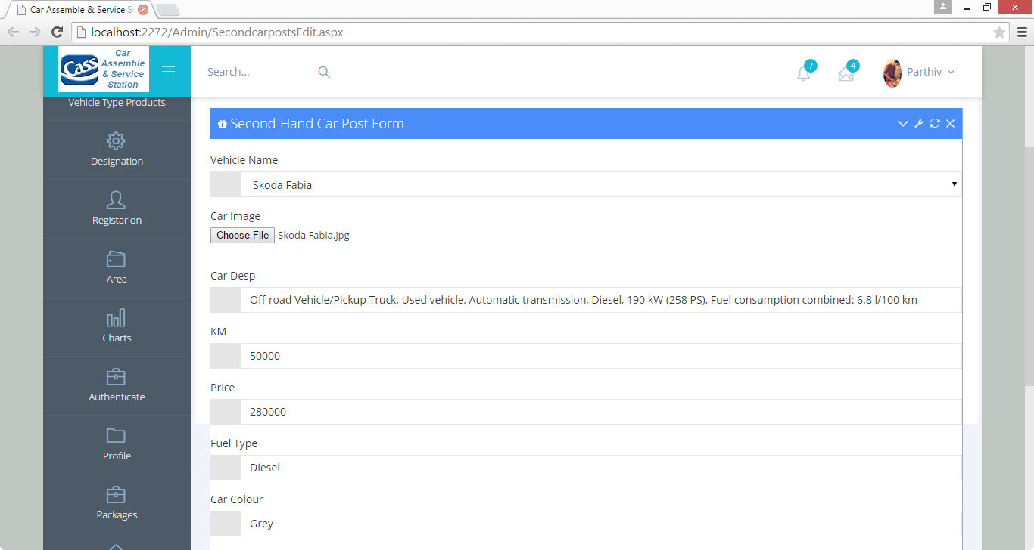
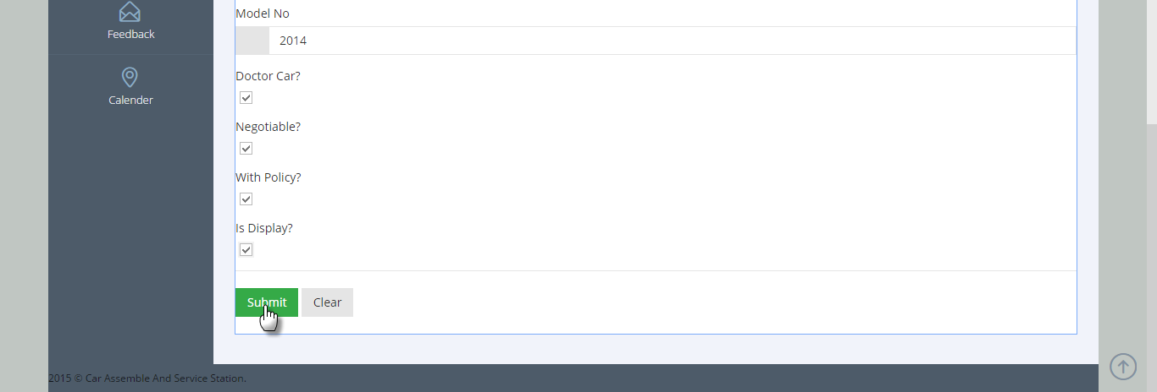
Add Second-Hand Car Post
Description :From this page, Admin can add new Second-hand car posts..

Slide 80
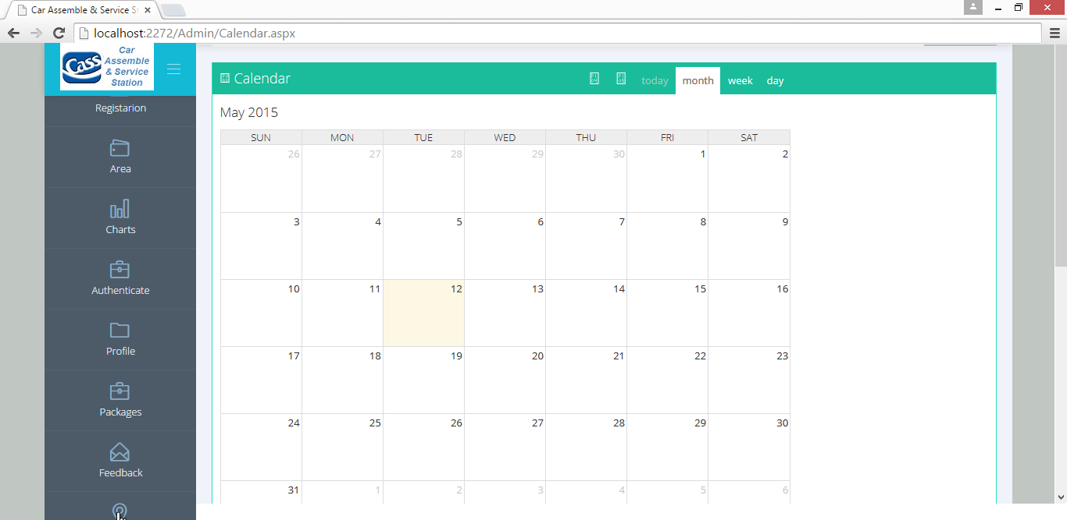
Calendar
Description: This is a Calendar Page; It will display a Calendar month, week even day events if any.

Slide 81
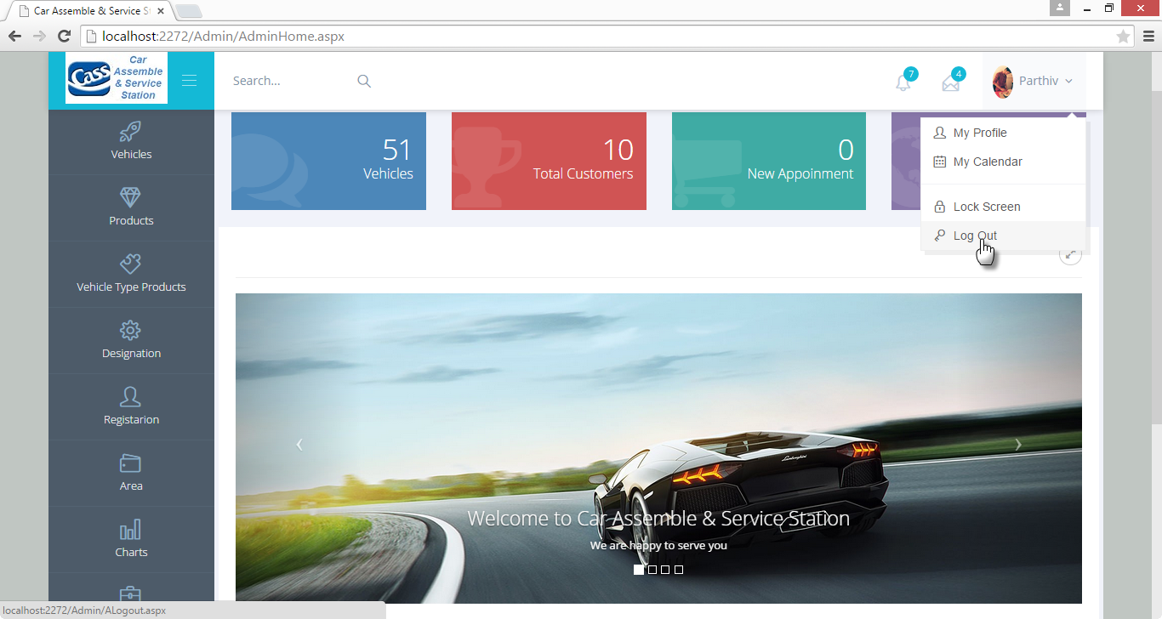
Sign-Out
Description: This is Sign-Out page; here Admin can sign-out from site.

Slide 82
Customer Side-Input-Output Design
Sign-In
Description: This is Sign-in Page; Here Customer can sign-in into site.

Slide 83
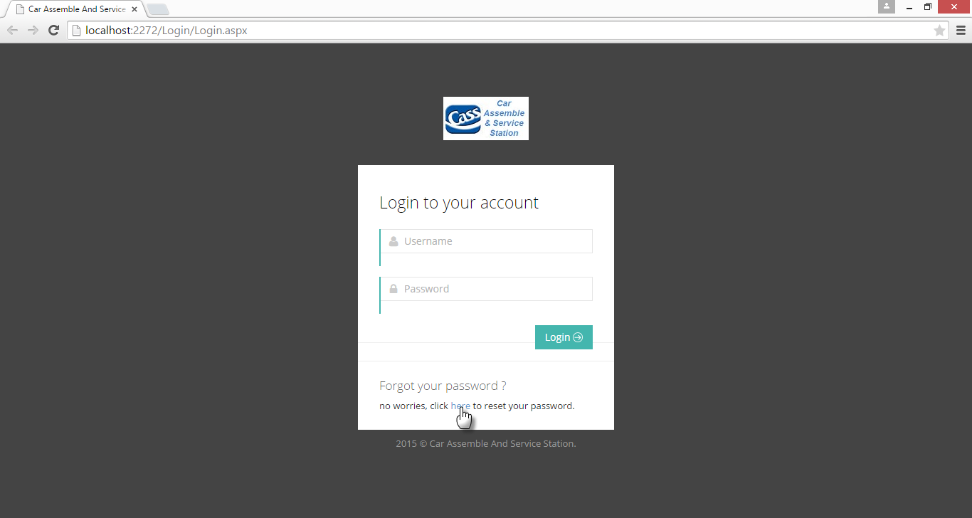
Forgot Password
Description: :- This is Forgot password page, if customer forgot his/her password.

Slide 84
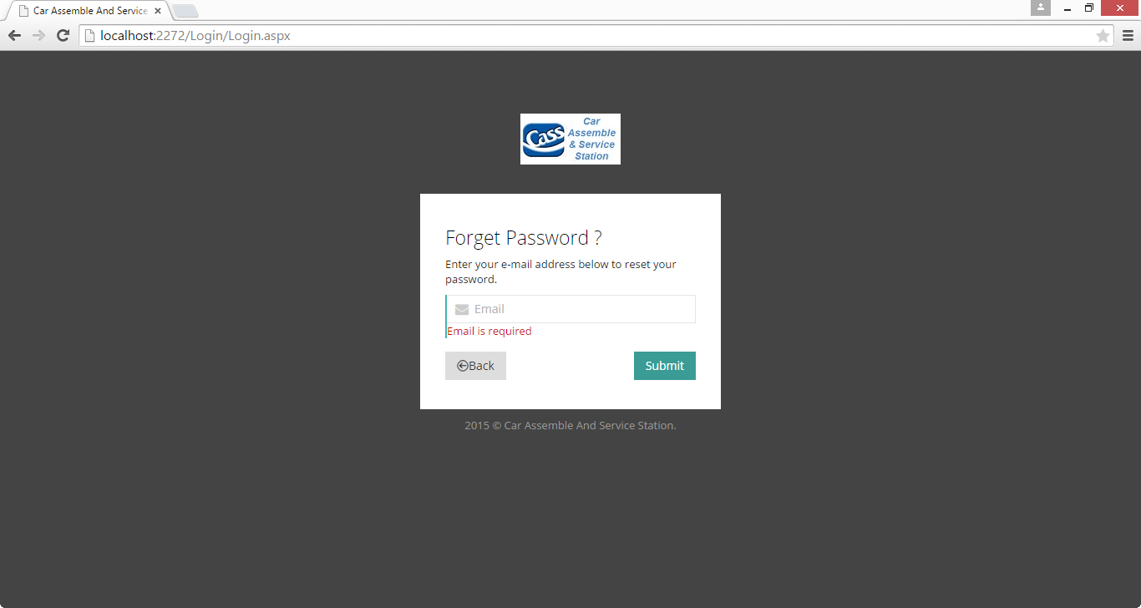
Forgot Password Validation
Description: This is Forgot password page, if customer does not enter his/her registered email address at that time validation occurs.

Slide 85
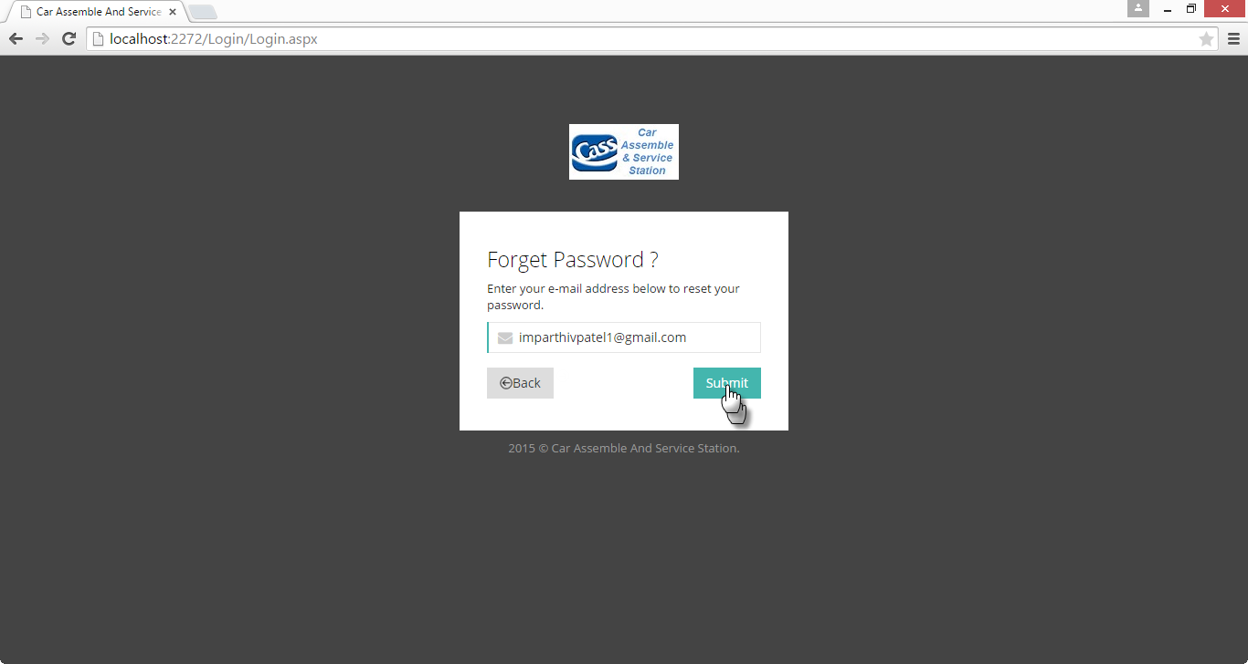
Forgot Password
Description: Here Customer can enter his/her registered email address and they can retrieve them password via Email.

Slide 86
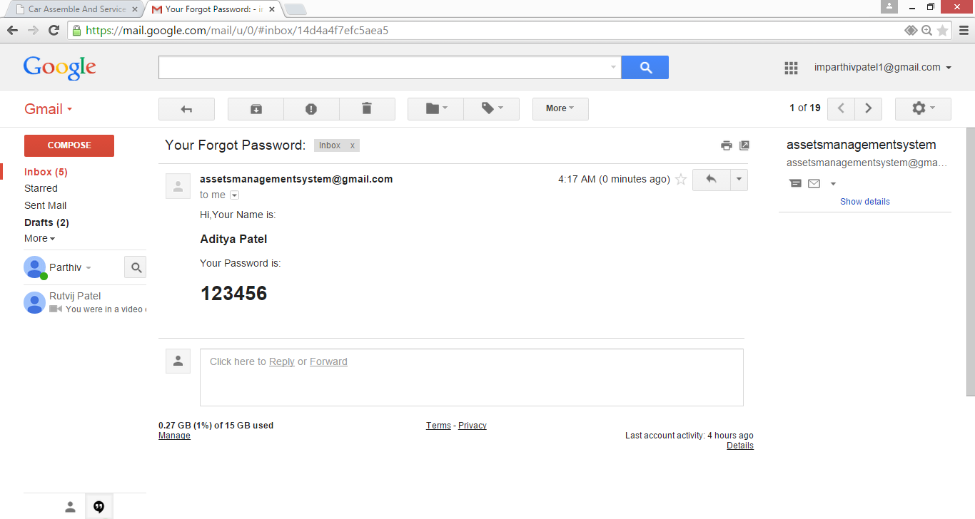
Confirmation Page
Description: Here Customer can get confirmation message in his/her registered mail box.

Slide 87
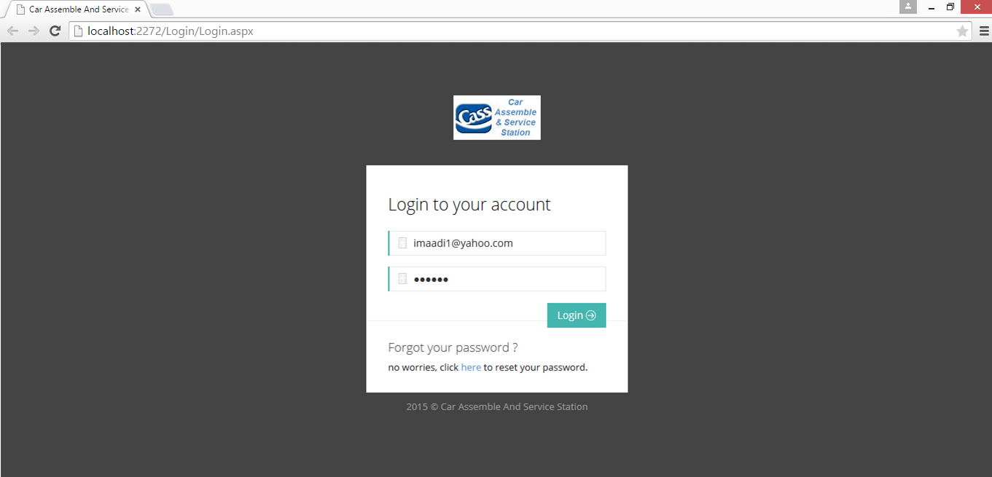
Sign In
Description: This is Sign-in Page; Here Customer can sign-in into site.

Slide 88
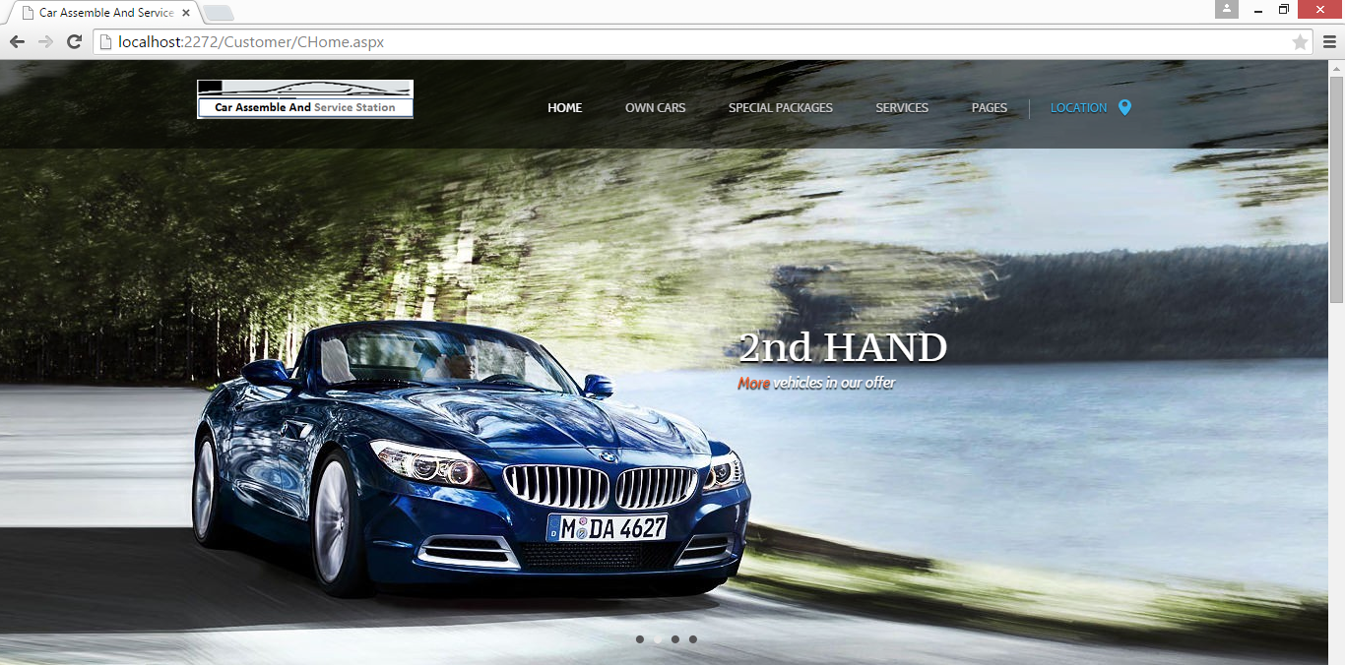
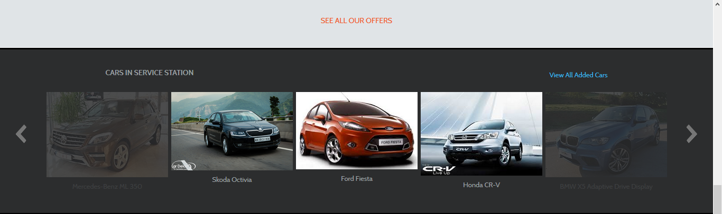

Home Page
Description:- This is Customer home page; Here customer can view all cars in service station.

Slide 89


Own Vehicle Page
Description: This is a own car page, Here Customer can select particular vehicle added by operator and can view all products of selected vehicle.

Slide 90



Product Page
Description: This is a Product page, Here Customer can see product of selected vehicle and can book appointment.

Slide 91

Book Appointment
Description: Here Customer can book his/her appointment.

Slide 92

Appointment Confirmation
Description: Here Customer can view his/her book appointment confirmation message in his/her registered mail account.

Slide 93


Choose Service Package
Description: Download Image.

Slide 94

Confirmation Service Package
Description: Here Customer can view selected service package confirmation message in his/her registered mail account.

Slide 95

Search Second Hand Car Posts
Description: Download file.
Description: From this page, Here Customer can search number of second hand car posts posted by Admin.

Slide 96



Search Second Hand Car By Searching Option
Description: - From this page, Here Customer can search number of second hand car posts posted by Admin via different searching option like Car colour, Car Name etc.

Slide 97


Search Second Hand Car By Searching Option
Description: From this page, Here Customer can search number of second hand car posts posted by Admin via different searching option like Car colour wise searching in this page.

Slide 98

Service History
Description: From this page, Here Customer can see his/her particular status of service.

Slide 99

Service History Detail
Description: From this page, Here Customer can view particular service history.

Slide 100

Sign-Out
Description: This is Sign-Out page, here Customer can sign-out from site.

Slide 101

Operator
Sign-in
Description: - This is Sign-In Page; Here Operator can sign-in into site.

Slide 102

Operator Home
Description: This is an Operator Home; Here Operator can perform various tasks.

Slide 103



Customer Registration
Description: From this page, Operator can register new Customer into site.

Slide 104

Customer Vehicle List
Description: From this page, Operator can Add, Update or Delete particular customer vehicle.

Slide 105

Add Customer Vehicle
Description: From this page, Operator can manage particular customer vehicle.

Slide 106

Manage Page after Performing Operations
Description: This is Customer Vehicle Page, Here Operator can see the Customer Vehicle list after performing Insert, Update and Delete Operations.

Slide 107

Service List
Description: This is Service List Page, Here Operator can see the Customer appointments taken for fit accessories.

Slide 108


Select Accessories as per Customer Requirements and Assign Task to Workers
Description: This is Service detail Page, Here Operator can select accessories as per particular customer need.

Slide 109



Select Accessories as per Customer Requirements and Assign Task Page
Description: This is Service detail Page, Here Operator can select accessories as per particular customer need.

Slide 110



Select Accessories as per Customer Requirements and Assign Task Page
Description: This is Service detail Page, Here Operator can select accessories as per particular customer need.

Slide 111

Assign Task to Workers
Description: From this page, Operator can assign task to particular worker.

Slide 112

Stock List
Description: From this page, Operator manage stock details.

Slide 113

Add Stock
Description: From this page, Operator can Add vehicle product stock.

Slide 114

Stock Page after performing Operation
Description: Here, Operator can view stock page after inserting particular vehicle product stock.

Slide 115

Workers Task Search
Description: - From this page, Operator can view status of tasks which is assigned to particular worker.

Slide 116

Workers Task Search
Description: - From this page, Operator can view status of task of selected worker.

Slide 117

Authentication Page
Description: From this page, Operator can change authentication of Customer.

Slide 118

Customer List
Description: From this page, Here Operator can view list of Customer registered into site and can also change his/her authentication.

Slide 119

Customer Authentication
Description: View password on his/her email id.

Slide 120

Customer Wise Package List
Description: From this page, Here Operator can view list of customers who are activated service packages with start date and end date information also.

Slide 121


Profile
Description: Operator profile page. Here Operator can view his own personal details and password.

Slide 122

Profile Avatar
Description: From this page, Operator can View and change his/her Avatar.

Slide 123

Change Password
Description: Here Admin can change his/her password.

Slide 124

Confirmation Message
Description: Here Operator view his/her change password confirmation message in his/her registered mail account.

Slide 125

Sign Out
Description: This is Sign-Out page; here Operator can sign-out from site.

Slide 126

Worker Side-Input-Output Design
Sign In
Description: This is Sign-in Page; Here Worker can sign-in into site.

Slide 127

Worker Home Page
Description: This is an Worker Home; Here Worker can perform various tasks.

Slide 128

Task Search
Description: This is Worker Task Search, Here worker can view tasks assign by Operator.

Slide 129

Print Page
Description: This is Worker Task Page; Here Worker can print out the task list.

Slide 130

Change Task Status
Description: From this page, Here Worker can view assign task details and can change status of particular task.

Slide 131

Change Task Status
Description: From this page, Here Worker can confirm that all tasks has been done and also operator and customer can see complete status when done by Worker.

Slide 132


Profile
Description: Worker profile page. Here Worker can view his own personal details and password.

Slide 133

Profile Avatar
Description: From this page, Worker can View and change his Avatar.

Slide 134

Change Password
Description: From this page, Worker can change his own password and also get confirmation Email in registered mail box.

Slide 135

Sign-Out
Description: From this page, Worker can sign out from the site.

Slide 136

Reports
Customer Vehicle Search Report
Description: From this report, Admin can view particular customer vehicles added by Operator. With vehicle name and vehicle particular number.

Slide 137

Customer Vehicle Search By Name Wise
Description: From this report, Admin can view particular customer vehicles added by Operator.

Slide 138

Stock Search Report
Description: From this report, Admin can view particular customer vehicles added by Operator.

Slide 139

Search appointments Between Two Dates Report
Description: From this report, Admin can view service appointment between start date and end dates.

Slide 140

Search appointments Between Two Dates Report
Description: From this report, Admin can view service appointment between start date and end dates.

Slide 141

Workers Task Search Report
Description: From this report, Admin can view task and it’s status assign to particular worker.

Slide 142
Testing
Test Case Id | 1
Test Case Created By | Admin
Case Type | 1.Non-Registered user 2.Wrong Username And Password 3.Correct Username And Password
Expected Result | 1.System Will Not allow non-register user to login 2.System throws an error and do not login 3.System redirect the page
Actual Result | 1.User cannot login 2.Display message “Username And Password Not match” 3. System displays the homepage of admin/Member.
Pass/Fail | 1.Fail 2.Fail 3.Pass

Slide 143
Testing
Test Case Id | 2
Test Case Created By | Operator Registration By Admin.
Case Type | 1.Required Field Validation 2.Fixed format validation 3.Range Validation
Expected Result | 1.Mandatory Fields should not be NULL 2.The Validation Expression Must Be determine 3. The Values must have predefined range.
Actual Result | 1.Fill Some Values into mandatory fields 2.User Should Enter Proper Email Id 3.User Mobile number.
Pass/Fail | 1.Pass 2.Pass 3.Pass

Slide 144
Testing
Test Case Id | 3
Test Case Created By | Worker Registration By Admin.
Case Type | 1.Required Field Validation, 2.Fixed format validation 3.Fixed format validation
Expected Result | 1. Mandatory Fields should not be NULL 2.The Validation Expression Must Be determine 3. The Validation Expression Must Be determine
Actual Result | 1. Fill Some Values into mandatory fields 2. User Should Enter Proper Numeric Value 3. User Should Enter Proper Email Id
Pass/Fail | 1.Pass 2.Pass 3.Pass

Slide 145
Testing
Test Case Id | 4
Test Case Created By | Customer Registration By Operator.
Case Type | 1.Required Field Validation, 2.Fixed format validation 3.Fixed format validation
Expected Result | 1. Mandatory Fields should not be NULL 2.The Validation Expression Must Be determine 3. The Validation Expression Must Be determine
Actual Result | 1. Fill Some Values into mandatory fields 2. User Should Enter Proper Numeric Value 3. User Should Enter Proper Email Id
Pass/Fail | 1.Pass 2.Pass 3.Pass

Slide 146
Testing
Test Case Id | 5
Test Case Created By | Unit testing(login)
Case Type | Without login
Expected Result | Admin ,Operator, Worker & Customer cannot enter into home page.
Actual Result | The page cannot response home page of Admin,, Operator, Workers and Customer.
Pass/Fail | Fail

Slide 147
Post Implementation Review
The important point that to keep during post implementation review is determining whether the Application has met its objective that is, analyst want to know if the performance level of users has improved.
Reviews are taken until Application fulfills user requirements. After implementation it is easy to manage the Application and is easy to solve the difficulties. In this all requirements are fulfill
User can send feedback and suggestions to the admin. Based on user feedback review, action is taken and solves user’s difficulties.

Slide 148
Future Enhancements
Customer can do payment Online.
Customer can easily contact to Car Assemble And Service Station.
Design/Layout Change as per client’s need.
Multiple language support through Google API.
Further the System will have the synchronization with Mobile Devices in two way communication.

Slide 149
Conclusion
Car Assemble And Service Station System will able to provide the solution it was expected to do. The expected outcome was to provide a new management system that reduces the manual work of company.
This web application in the response to that will provide management system. Along with that it provides task management of workers, history of services, product stock usage.
Along with that it will also provide a new service mechanism. This will reduce the work of employees.
In conclusion, Car Assemble And Service Station is in process of setting up as per the standards and qualities it was required to be. It can help company to work more efficiently and effectively in future.

Slide 150
Bibliography
References Books: -
ASP. Net: The Complete Reference 1st edition
TATA McGraw Hill Education Private Limited
ASP. Net 4.5 (Covers C# and VB codes)- Black Book
Website :w3Schools.com www.stactoverfolw.com www.scn.sap.com www.c-sharpcorner.com https://developers.google.com http://www.codeproject.com

Slide 151
Thank You….

